Slide 1
An Introduction to Feasibility Analysis:
An Annotated Presentation
presented to ASU MRED Program
by James R. DeLisle, Ph.D.
February 10, 2010
(annotations modified 2.16.2010)
Notes:
This was something of an impromptu presentation I made to students in the Master of Real Estate Development (MRED) program at Arizona State University. The topic was selected to present some materials that might be relevant to a synthesis project in which they were engaged at the time of my visit. Given time constraints, I was not able to go over the presentation in detail so I opted to provide them an overview of the feasibility process. As such, I tried to expose them to a general framework and introduce some basic feasibility concepts and examples. While this decision allowed us to review the fully array of issues that should be considered in feasibility studies, it was at the expense of depth of inquiry that would be necessary to help them understand how to integrate the concepts into student projects. To help address that void, I have added annotated comments to my slides and included other illustrative materials.

Slide 2
Feasibility Process
Definition of Feasibility Problem
  General Problem Statement
  Client Perspective
Strategic Evaluation
  Positional Analysis
  Selection and modification of Feasibility Model
Data Selection and Collection
  Capital Market Profile
  Spatial Market Analysis: Macro and Micro
Preliminary Analysis and Identification of Alternatives
  Spatial Considerations
  Financial Considerations
Use Filtering and Selection of Most Likely Candidate
  Goodness-of-fit criterion
  Satisfaction of Client Goals
Refinement of Alternative and Verification of Use
  Product Specification
  Risk Management and Due Diligence
Implementation, Monitoring and Feedback
Notes:
One of the most difficult challenges in reading feasibility studies can be traced back to inherent flaws in our ability to master the English language itself; weak spelling skills. That is, there are “Feasibility Studies,” and then there are “FEEsibility Studies.” The latter are driven by the search for consulting revenue in world in which many clients are looking for “research” which will support their a prior conclusions. Unfortunately, there are more than a few consultants who are willing to “tell it like they want to hear” vs. “tell it like it is, or will be….” Once getting beyond these agency issues, Feasibility Analysis can be reduced to a process. However, rather than a static process that takes on a linear form, feasibility studies often requires one to take the scenic route. That is, in many cases the critical thinking necessary to properly discharge a feasibility study can lead to a variety of avenues, with the “path less taken” often the most creative and rewarding. Thus, many linear thinkers and red personality types are frustrated by feasibility analysis since it requires a degree of non-linearity and a willingness to challenge convention and “obvious solutions” that can entice one into intuitively attractive but inherently flawed solutions. That said, feasibility studies still follow a disciplined decision-making process which begins with problem definition and culminates in Implementation, Monitoring and Feedback. Indeed, the latter stages are part of the continuous learning process in real estate which helps advance the body of knowledge and allows us to continuously enhance best practices as we seek optimal uses and a better goodness-of-fit between the spaces we create and the underlying demand for space.

Slide 3
The Definition of Real Estate
  Artificially delineated space over time with a fixed reference point to the earth…
Money-time
Space-time
Notes:
A fundamental building block for Feasibility Analysis is an understanding of the dimensionality of the real estate product construct. Real estate has two key dimensions: the spatial dimension, and the capital dimension. In my opinion, real estate success is 70% spatial fundamentals and 30% capital fundamentals. Unfortunately, over the past decade, the equation has been inverted. This disconnect and imbalance was both a cause and effect of the recent bubble in commercial and residential markets. To return to a semblance of balance, the market must be shifted back toward longer term, more sustainable solutions which build on the spatial side of the equation.

Slide 4





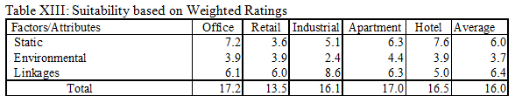
Dimensionality of Real Estate
What are the three key dimensions of Real Estate?
S….
E….
L….
Static
Linkages
Environment
  S…. E….. L ….
For more info on using in Feasibility Studies, see Case 4: http://jrdelisle.com/cases_tutorials/
Notes:
This slide conveys one of the building blocks for the real estate discipline. It recognizes that the spatial component of the underlying product construct is comprised of three key dimensions: static attributes, environmental attributes and linkage attributes. The static attributes are the "physical" attributes of the structure and site. They represent tangible elements including materials, quality, design, and quantity. While these items are relatively "fixed," it should be noted that the utility of value they constitute can be dynamic, changing over time due to changing customer preferences, regulations or other factors. The environmental attributes consist of the immediate surroundings on contiguous sites and/or environs; sometimes referred to as Neighborhood attributes. They include both natural and manmade elements along with nature, quality, intensity, image and other elements that in the aggregate, define the setting in which a particular parcel is found. The linkage attributes refer to connections between a particular parcel of real estate and ancillary or related sites; key linkages include employment, shopping, housing, etc. It should be noted that the quantification of these attributes includes both actual and perceived distances in a behavioral context.
The significance of the SEL paradigm is that all three dimensions are undergoing continuous change, some of which is gradual and some of which is abrupt. As such, the underlying product of real estate is inherently dynamic and ever-changing. This argues that real estate cannot be passively managed; that value creation and maintenance are on-going activities that require specialized expertise and attention and resource commitments. As noted in the table, each use would apply different weightings to the criteria given their particular spatial requirements (this could be more precise at the property sub-type). Now, with the saliency or weights attached, the SEL can be rated against the evaluative criteria of the space user and the weighted*rated totals could be established. Now it’s a matter of picking the uses with the highest scores as the most likely candidate users and subject them to more analysis.

Slide 5
Three Major Attributes of Real Estate
Three major attributes of real estate . . .
  L,
  L,
  L.
Three major attributes of real estate . . .
  L,
  L,
  L.
L
  . . . . . . . ulnerable,
  . . . . . . . ulnerable,
  . . . . . . . ulnerable.
L
L
The 2009 regime of real estate . . .
  D
  D
  D
  . . . . . . . istressed,
  . . . . . . . istressed,
  . . . . . . . istressed.
The 2010 + regime of real estate . . .
L, L, L
Butt, what the “L”?
Liability, Litigation, Liquidity (NOT!)
Notes:
This slide is designed to disarm the audience a bit and get them thinking creatively and out of the box. The play on the Location, Location, Location theme points to the Vulnerability of real estate due to the potential impact of a range of externalities. It also introduces the “D” word for distress. We also talked about the dreaded “R” word which to some might be “Recession” but to developers is “Recourse” which is coming in future loans resets which are hanging over the industry.
In something of a return to fundamentals, the L, L, L is back in vogue for 2010. Unfortunately, instead of Location, Location, Location, they will stand for Liability (recourse for borrowers), Litigation for a lot of players, and Liquidity (NOT) reflecting the inability to access debt capital and the challenges sellers will face when the glut of distressed assets clouds the market.

Slide 6
Types of Real Estate Feasibility Problems
Site in search of a use
  Profile site
  Identify alternative uses and users
  Match most probable user to site
Use in search of a site
  Profile user and establish real estate needs
  Identify alternative sites
  Match site to user
Investor in search of involvement
  Profile investor
  Establish investment criteria
  Identify alternatives
  Match investor to alternatives
For more background, see Graaskamp: A Holistic Perspective at http://jrdelisle.com/research/
Notes:
The late James A. Graaskamp developed a typology of Feasibility Problems including: site in search of use, use/user in search of site, and investor in search of involvement. This classification system remains valid today and can be used to help develop the problem statement and research design for a variety of real estate decisions.

Slide 7
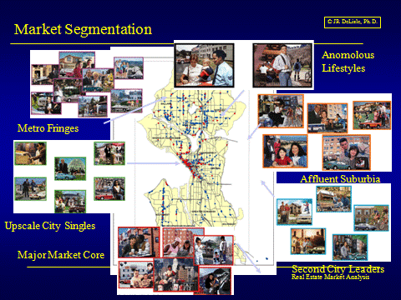
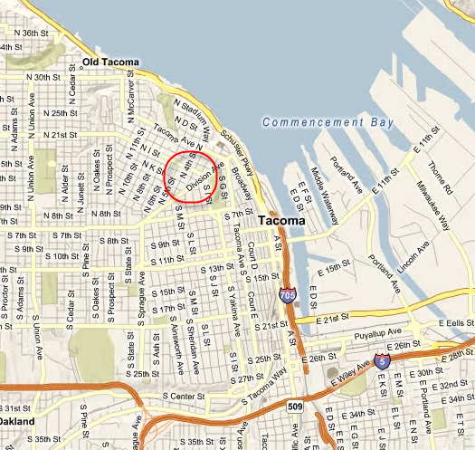
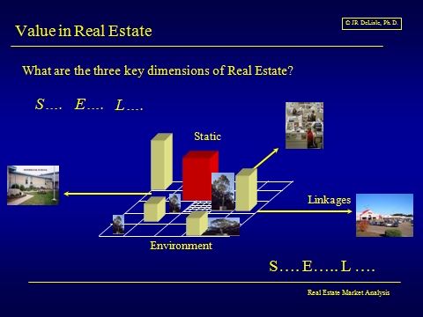
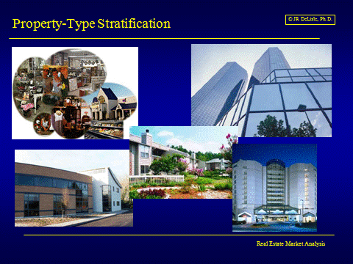
Site in search of a use
Site in search of a use
  Profile site
  Identify alternative uses and users
  Match most probable user to site
Notes:
The “Site in Search of a Use” is is a classic problem and represents one of the more challenging type of feasibility studies. In this case, the analyst starts with a piece of dirt or a property, and then explore alternative uses to determine which one best satisfied the goals and objectives of the client. To "optimize" the solution, the analyst starts with the site, explores it in the context of the broader market, identifies potential uses, segments the demand side for the potential uses, develops an empathy with each potential user, reverse engineers the process to rank-order the site in terms of attractiveness to the potential users, analyzes the marketability and financial viability of the potential uses and users, and the selects the "most probable use" and "most probable user" who will be the optimal consumer of the ultimate space. As such, the analyst should establish sufficient "empathy" with the potential users to figure out how to best fit of use of the site. This type of analysis will help contribute to the balance in the market, as well as insulate the project from downturns in the market that will erode the demand for more "generic" solutions that have less built-in friction and less customer loyalty.

Slide 8

Use in search of a site
Classify User: Assess Needs
Use in search of a site
  Profile user and establish real estate needs
  Identify alternative sites
  Match site to user
Notes:
The “Use in Search of a Site” type of study begins with the client, allowing the analyst to focus directly on their goals and objectives for real estate. In addition, the analyst can generally focus on more strategic issues, allowing them to take a more proactive approach to real estate than if merely on the "match-making" side. That is, many clients or users may view real estate from a minimalist perspective, seeking to cut costs and focus on the bottom line. To the extent the analyst has access to key decision makers within the firm, he/she can use the consulting relationship as an opportunity to enhance awareness of how real estate can be used as a strategic asset to enhance the top line of the firm. This higher value-add can be manifested in easier recruiting and retention of employees, higher productivity levels and lower absenteeism, and higher customer demand associated with both the image and accessibility offered by the real estate. This latter element is particularly important in the case of retail clients and other businesses in which face-to-face contact with customers is an essential matter to the underlying business activity to be housed.

Slide 9

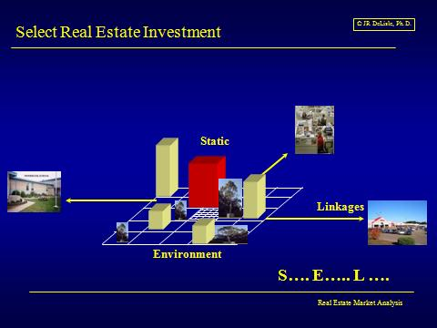
Investor in search of involvement
Private Investors
Investor in search of involvement
  Profile investor
  Establish investment criteria
  Identify alternatives
  Match investor to alternatives
REITs
Pension Funds
Foreign Investors
Public Untraded Funds
Life Insurers
Notes:
The “Investor in Search of Involvement" type of study can take a number of forms, depending on the type of client and the role that real estate plays in their broader portfolio. In a number of cases, investors may be somewhat naive with respect to real estate, seeking it as a diversifier to a mixed asset portfolio. In other cases, investors may have tremendous real estate acumen in general, but lack insight into a particular market or property sector. Before approaching the assignment, the analyst should probe into the underlying rationale, playing particular attention to return requirements, risk tolerances, liquidity needs, capital capacity, perceived role of real estate, and related investor-specific factors. It should be pointed out that the "use in search of a site" or a developer in search of an project also enfolds some of the elements of the "investor" profile

Slide 10
Ten Steps to Feasibility Site in Search of Use
Problem Statement
Situational Analysis
Legal-Political-Ethical
Physical-technical
Dynamic Location Attributes
Market Trends and Needs
Market Analysis
Alternative Site Specification
Alternative Site Analysis
Project Strategy and Profile
Notes:
A ten step program can be followed to help guide the feasibility process. Again, it should be noted that this framework is presented as a guide; in most cases, feasibility analysis is a non-linear process which benefits from some feedback loops and periodic revisiting of assumptions and preliminary decisions. That said, it is important to ensure that the basic steps have been included or, if not in the scope of analysis, explicitly identified as assumptions beyond the scope of the analysis.

Slide 11
A Definition of Feasibility
A real estate project is “feasible” when the real estate analyst determines that there is a reasonable likelihood of satisfying explicit objectives when a selected course of action is tested for fit to a context of specific constraints and limited resources.
James A. Graaskamp
For more background, see Graaskamp on Real Estate
Notes:
One of the distinguishing elements of a feasibility study is that is customized for a particular client in a particular situations. Thus, a feasibility study may not identify the optimal use for a site or the best solution for the broader market, but will be customized per the letter of engagement. To the degree to which a study is customized for a particular type of client/situation, the analyst should explicitly state the limited focus and the evaluative criteria used to frame the general question and support the ultimate conclusion. Note that there are no absolutes or guarantees that the solution will work, but that there is a reasonable likelihood of its occurrence. As such, the analysis should incorporate risk-management processes and the level of analytics necessary to reduce risk to a tolerable level.

Slide 12
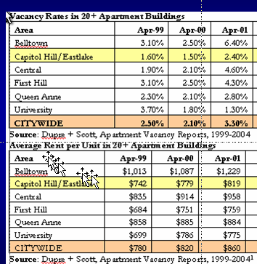
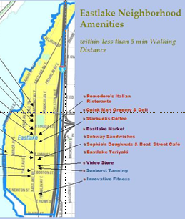
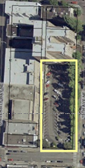
Project: Process Overview
Notes:
This slide provides an overview of the “site in search of a use” feasibility project I have students prepare in my Real Estate Process course. This is the introductory real estate course and is taught to an interdisciplinary pool of students. The objective of the project is to help students understand the overall decision-making process, focusing on the breadth of analysis rather than the depth of analysis. At the same time, students are exposed to the basic analytical and technical tools necessary to identify sustainable, market-based solutions which can optimize land use decisions and create economically viable and marketable projects which also enhance the quality of the built environment. This overview slide includes some examples of student work.

Slide 13
Step 1: Problem Statement
Strategic Overview
Nature of Decision
Goals and Objectives
Business Considerations
Constraints
Scope of Analysis
  Inclusive vs. exclusive approach
  Dynamic vs. static approach
  Stochastic vs. deterministic
Notes:
One of the critical elements of any type of study is a clear articulation of the underlying problem. This includes an explanation of the type of decision(s) that must be made, as well as the scope of decisions being explicitly supported by the analysis. While many decisions can be lumped into major categories, the discussion should expand on these generalizations to cover some of the more subtle elements that will lead to more valid and reliable results. The discussion should address the strategic elements of the decision as well as some of the key tactical issues
The problem statement should explicitly address the goals and objectives of the client. In many cases, it will be difficult to quantify these elements up front. Despite this difficulty, unless they are identified, there will be no way of determining whether the ultimate recommendation will be successful. Rather than getting hung up on issues that cannot be easily quantified up front, placeholders can be used. The discussion should address not only the decision, but other business considerations that set the context within which the decision must be made. A review of the background underlying the decision will often be appropriate, including the factors that lead up to the specific problem being addressed in the study. The constraints that limit options or resources should be noted although in many cases the analysis should explore alternatives that might mitigate some of the constraints.
The scope of analysis should be discussed to set the context and help establish the boundaries of inquiry. In general, feasibility studies benefit from a more inclusive approach which pushes the boundaries that are initially established to ensure the results are robust and contain some “out of the box” creative thinking. The approach should be dynamic and forward looking rather than static and backward looking. Finally, the analysis and results should be presented in terms of “expected outcomes” and include some statement of the probability of success.

Slide 14
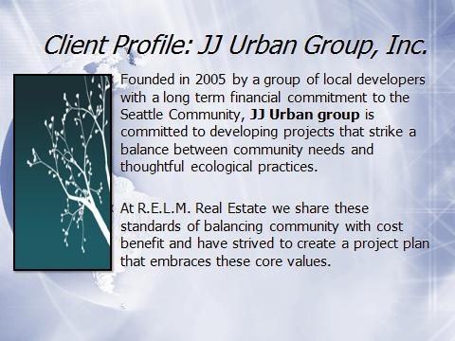
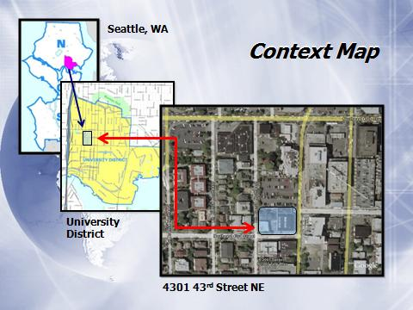
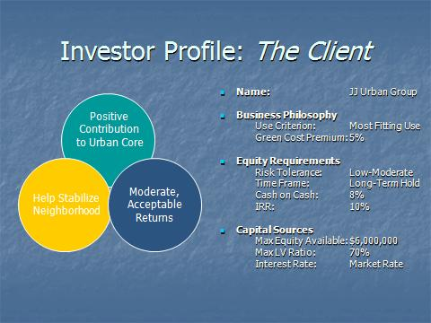
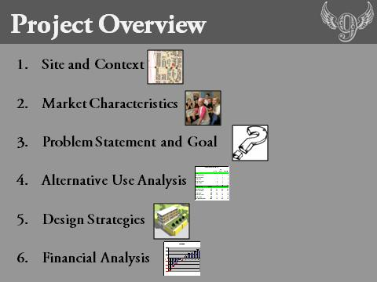
Context: Problem Statement
Notes:
This slide consists of some examples of how my students have established the context and problem statements in there presentations. As noted, there is no one way to present the materials although some combination of visual and textual materials is often indicated. The triple-bottom line presented in the lower left is a useful framework that explicitly entails the “sustainable real estate” dimension of many real estate problems.

Slide 15
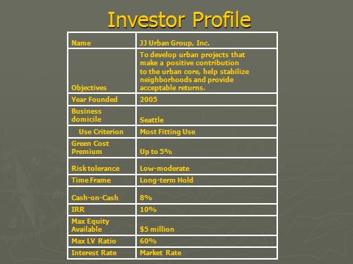
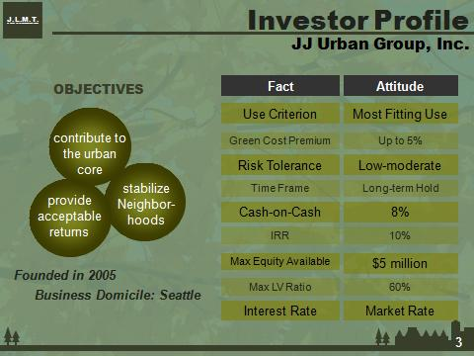
Investor Profiles
Notes:
This slide summarizes the investor profiles which can be used to establish the evaluative criteria being applied in the study. Rather than just listing the items, their implications should be noted to help set the stage for the analysis. This framework can also be used later in cases where some of the constraints and/or a priori assumptions or objectives are too limiting and turn out to be deal-breakers. Since the items have been quantified up front, they can be relaxed to determine whether a project that appears to be infeasible can really work under a different set of constraints or goals that have been modified to adjust to current market realities vs. normative hopes or expectations.

Slide 16
Step 2: Situational Analysis
Strategic Overview
  Macro-economic Environment
  Capital Market Environment
  Spatial Environment
  Space User Environment
Preliminary Site Assessment
  Situational Analysis: The Context
  Positional Analysis
    Context in which it fits/operates
    Draws on Structure, Succession and Situs Theory
  Opportunity Analysis: What it could be?
Notes:
Since real estate decisions have both a space-time and money-time component, it is important to establish the situational context. This analysis should be longitudinal, focusing on the current status but at the same time, taking a forward look. This temporal frame is critical to identify market-based solutions that are sustainable in the sense they have sufficient demand today and in the future to justify the irretrievable commitment of scarce resources they entail. At the same time, the coverage of the analysis should be fairly broad covering the macro-economic environment (e.g., economic growth, employment, confidence), the capital markets (e.g., capital flows, required returns, preferences), the spatial markets (e.g., supply at a stratified level), and the space-user market (e.g., demand for space at a segmented level).
In addition, Situational Analysis should include a strategic assessment, exploring how the site/structure is positioned relative to the broader market. This analysis will benefit from applied urban land economics which draws from Structure Theory, Succession Theory and Situs Theory (search my JRD Glossary for more detail).

Slide 17
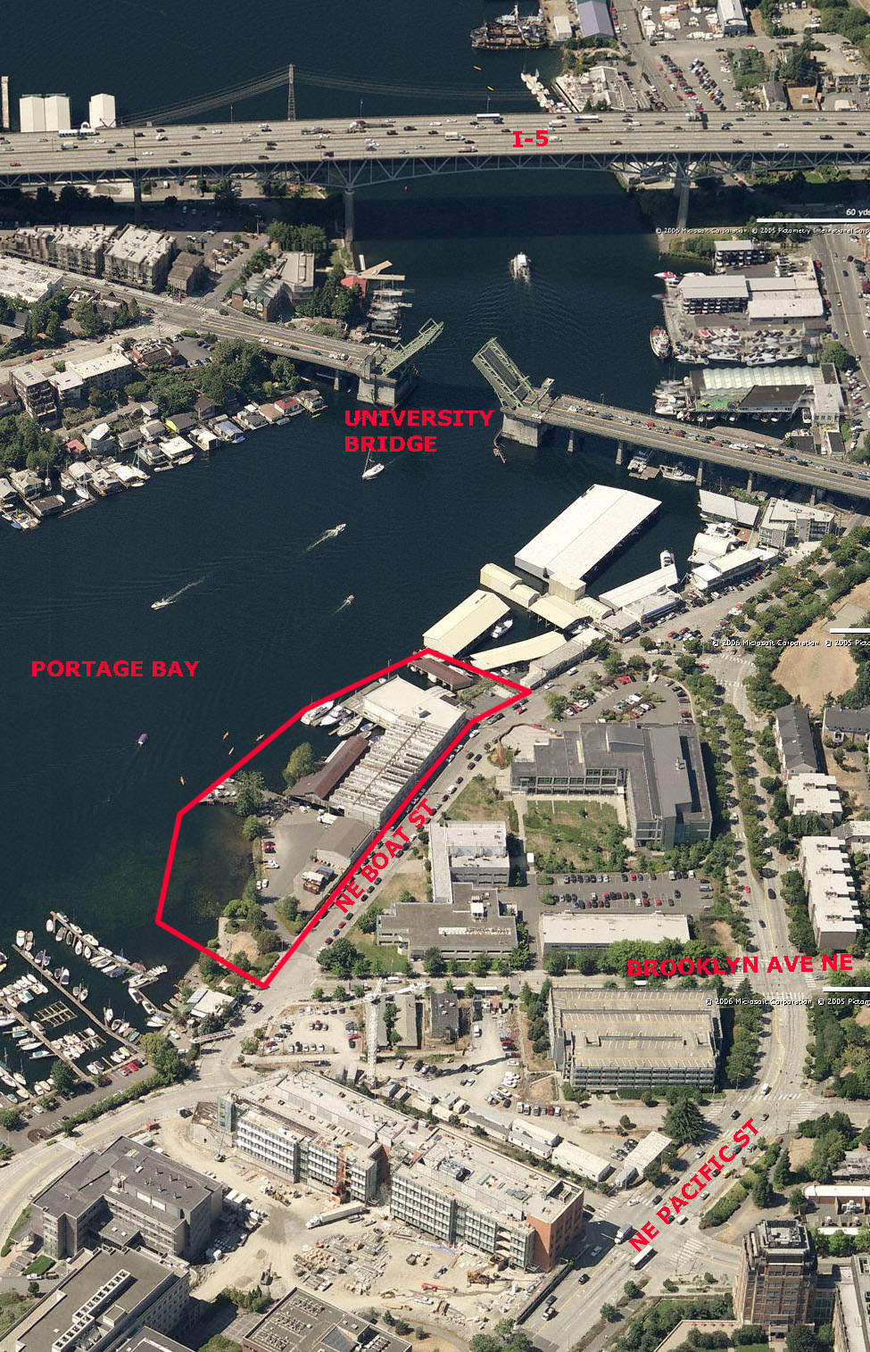
Situational Overview
LOCATION:
Portage Bay
U-District
Brooklyn Ave NE and NE Boat St
UW Campus north of site
Water to South
ZONING:
IC-45-US zone
179,567 sf lot
50,200 sf max over land
39,584 sf max over water
Notes:
This slide presents the situational context for the subject site, blending visual and textual materials to set the stage. To maximize the message, the map also points out some of the connections and linkages for the site rather than merely its layout and static features.

Slide 18
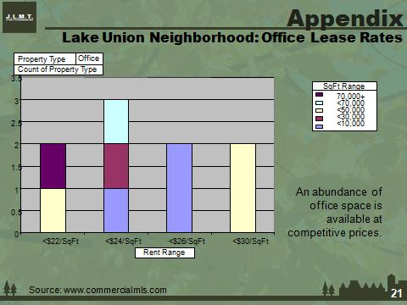
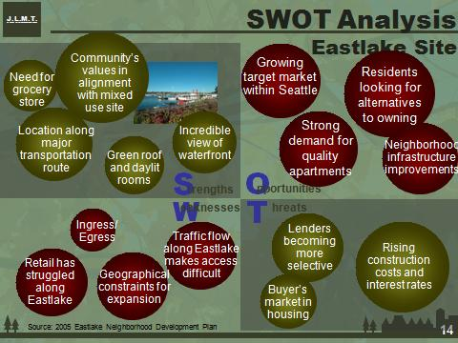
Competitive Analysis
Notes:
Although the focus of a feasibility study is often on a specific project in a specific location, to place that property in a proper perspective it is important to provide a brief overview of the structure of the broader market. The level of detail that should be explored in this discussion will depend on the nature of the underlying feasibility question. In many cases, it will be appropriate to present the market structure through the use of visual materials that highlight the various components of the larger market and position the site within this broader, more strategic context. To develop are more strategic or proactive view of the market, the discussion should explore the key drivers or factors that have influenced the structure of the market, as well as those that are likely to influence future growth.
One of the key elements of the "market" that will affect many real estate decisions is the "economic competitiveness" of the region and/or market. This element is particularity important to land use and sub-market decisions that are dependent on growth and market dynamics to fuel the relevant real estate market. Special attention should be paid to factors that differentiate the market from its peers. It should also be pointed out whether these elements are temporary, caused by some cyclical factors, or whether they are structural and will have an enduring affect on the market.
The classical Strengths, Weaknesses, Opportunities and Threats (SWOT) analysis can provide a useful framework for identifying the key drivers that affect the competitive analysis. Once identified, these elements can be scrutinized to determine if they can be mitigated and/or if they are durable or subject to change. This will allow the analyst to be more strategic and explore whether the apparent constraints or disadvantages can be resolved, as well as help quantify the risk side of the proposition in terms of dynamic, competitive market forces.

Slide 19
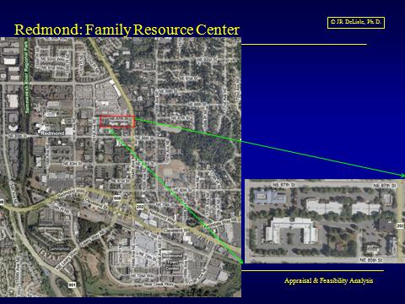
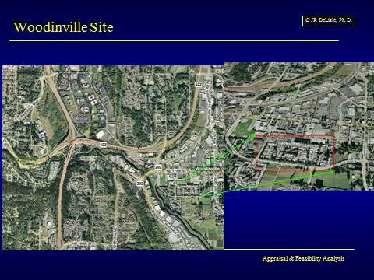
Step 3: SEL-Physical/Technical Context
Static Attributes
Size and shape
Topography
Drainage, water
Soils and subsoils
Utilities
Ingress/Egress
Dynamic Attributes
Functional layout
Orientation
Scale & texture
Comfort
Security
Nuisances/Environmental Issues
Notes:
The discussion of the targeted site --aka subject property in appraisal-- should provide a concise explanation of the site that is the focus of the study. The site profile should refer to the general shape of the site, as well as its size, topography and other physical elements. In many cases, the physical dimensions of a site will have a significant impact on the optimal use decision, especially where the site has characteristics that differ from those of the broader market. Although somewhat technical in nature and often beyond the scope of direct inquiry by a feasibility analyst, the type and condition of the underlying soils should be considered in the use decision. The topographical features of a site can have a number of strategic and tactical impacts on the optimal use decision and should be carefully weighed in feasibility studies. This caveat is particularly important in the case of height restrictions, views and other considerations that might make the relative elevation and slope of a site important to various user groups.
In many areas of the country, the affect of various development patterns on drainage and run-off will trigger heated debates. Such concerns should be approached with cautious, disciplined eye, especially in situations or use scenarios that dictate a high concentration on non-permeable surfaces that could exacerbate an already difficult situation. In some markets and sub-markets --especially more rural areas-- natural resources that are on site, or dependent on a particular site-- can create significant concerns. In most urban areas, it is generally assumed that utilities will be a fungible commodity, having little impact on optimal use decisions. In reality, however, the different needs for basic utilities and services by property type and sub-type can have a significant impact on the types of uses and users that can be adequately served on a given site.
The dynamic attributes of site and structure refer to the design elements, as well as the functional or market obsolescence. They should be viewed from a behavioral perspective, reflecting empathy with the most likely users or uses for the site or structure. While many of the elements can be quantified, others are more subtle and dependent on perceptions and subjective interpretations. Despite the difficulty in objectively assessing such dimensions, these "intangible" elements are often of critical importance to the real estate market.

Slide 20
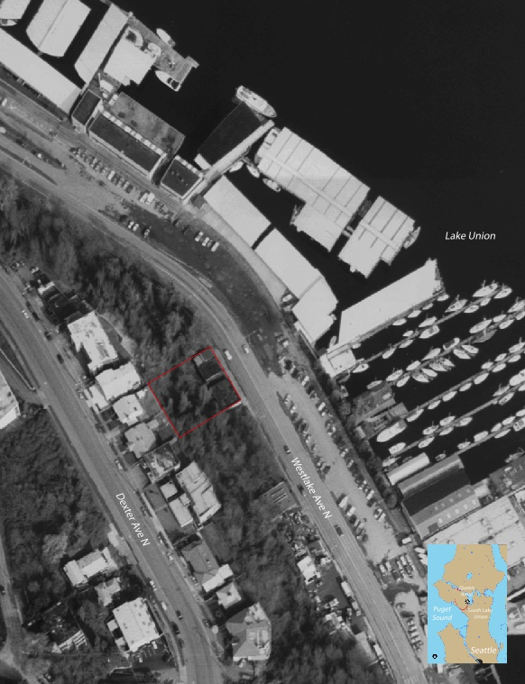
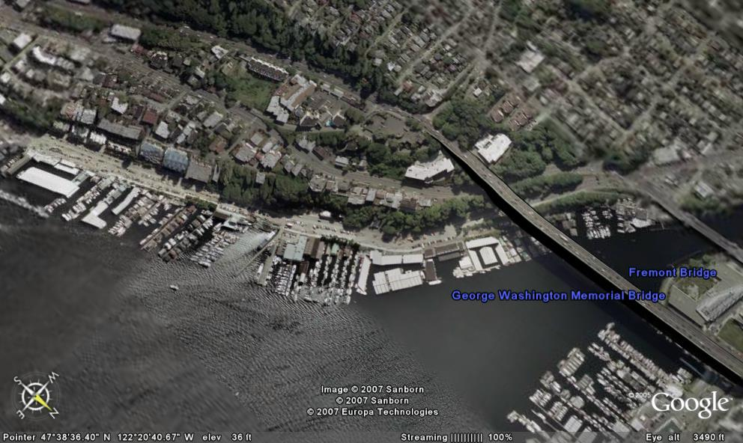
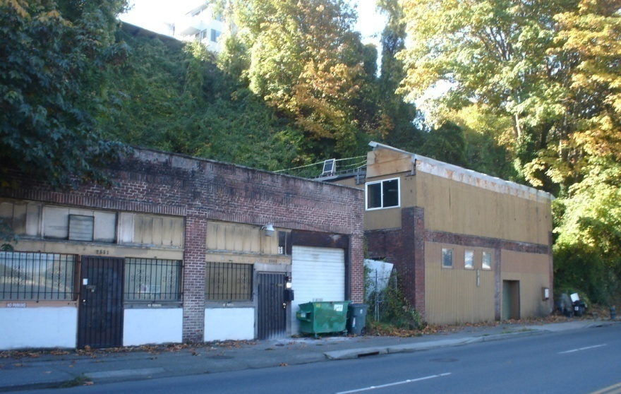
Static and Environmental Attributes
Jones ◊ Rappe ◊ Chang Consulting, LLC
Notes:
This slide presents both the static and environmental attributes focusing on the immediate environs and context within which the respective sites are noted. The picture in the lower left can be useful in helping the user understand the nature and quality of existing structures and site attributes. If there is an existing building (s) on a site, the improvements should be profiled. This approach should be followed in most studies, including those in which the client assumes the site will be scraped. Even in this situation, a profile of existing improvements can suggest a base line or floor in the adequacy of utilities and services with respect to certain intensities of use. In addition to providing a quantitative assessment of existing improvements, the discussion should also point out their general condition and current use.
In addition to evaluating the current uses of an existing building in terms of land use and tenant profiles, a feasibility study that looks at the relative "positioning" of existing assets in terms of their generic versus customized profile will be of particular importance to feasibility analysis. In addition, the analyst should make some assessment of the "malleability" of existing buildings to determine if there is an adequate reward/incentive system to support repositioning of the underlying asset in the market it serves.

Slide 21
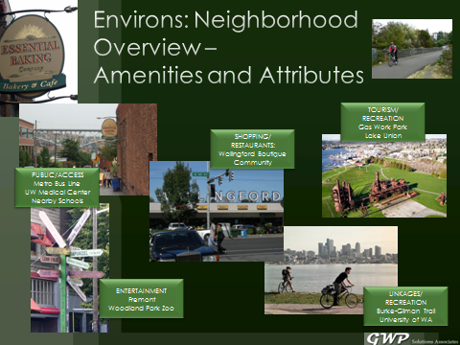
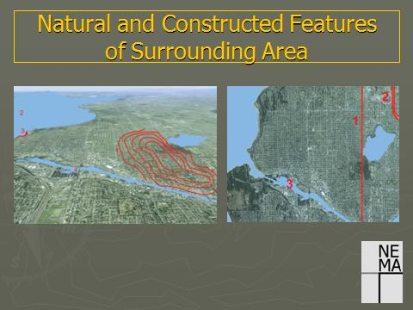
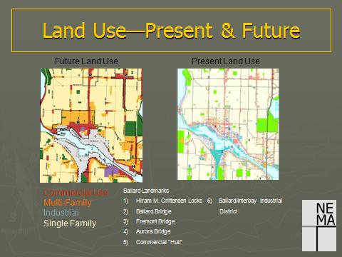
Environmental Attributes
2006 Team B1
Notes:
To help position the site, the discussion should provide a snapshot of contiguous properties and the surrounding environment. This analysis should look at a number of physical usage and entitlement factors. In general, structural analysis will take a cross-sectional approach, exploring the current market structure. In a number of situations, market synergy can occur within land use categories as in the case of housing where residents develop as sense of identity and comfort by being surrounded by other residents who are either similar or compatible in lifestyle, demographics and behavior.
As with other attributes, the analysis should address the longitudinal or temporal nature of the environmental context and include forward looking elements which consider emerging trends and evolutionary patterns. This could be accomplished by providing an overview of the trends or growth patterns and trends that are occurring in the broader market as well as in the general location in which the site is located.

Slide 22
Dynamic Location Attributes
Geographic Location
  Orientation
  Linkages
  Tributary analysis: connection
Transportation Access
  Mode
  Physical Access: Walkability
  Travel anxiety or aggravation
Exposure
  Visual
  Ingress/egress
Notes:
Locational analysis should be based on two drivers; the general submarket in the broader market in which it is situated, and the market, submarket or trade area within which it competes for space users and/or market support. Two dimensions of linkages are important to the real estate market; the physical path, and the perpetual path or the "perceived linkage" among key uses that are ancillary to, or supportive of, the recommended use. Thus, the analyst should present a summary of the routes and distances that connect key places, using maps or other graphics as appropriate.
Vehicular and pedestrian circulation routes in the immediate environs will be one of the key issues that affect the potential uses of many sites. In this analysis, special attention should be paid to major arterials and other "connections" that provide linkages to other sub-markets or to major transportation corridors. In addition to pointing out the corridors, the discussion should indicate the traffic flows within, and through, the neighborhood. With respect to pedestrians, the discussion should indicate street and sidewalk corridors, along with special walking paths and bike routes.
Locational analysis should address the exposure of the site, both in terms of it’s visibility as well as the ease of entering or exiting the site. The visual exposure will be a function of the width of the site, improvements and/or signage, traffic intensity, congestion and speed. Ingress/egress is a critical variable and can have a significant impact on the viability of potential uses of a site, especially in light of traffic volumes, congestion and/or barriers. For example, an apparently great site location that is on the opposite side of the flow of traffic on a high volume corridor with limited turn lanes and/or traffic lights, will not support convenience stores and similar uses. Indeed, the higher the traffic count, the less accessible and hence viable will such uses be unless drivers can easily enter and exit the site.

Slide 23
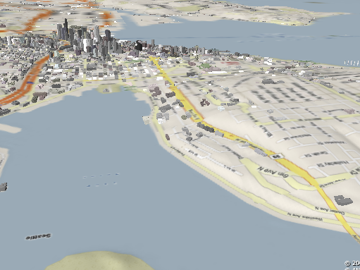
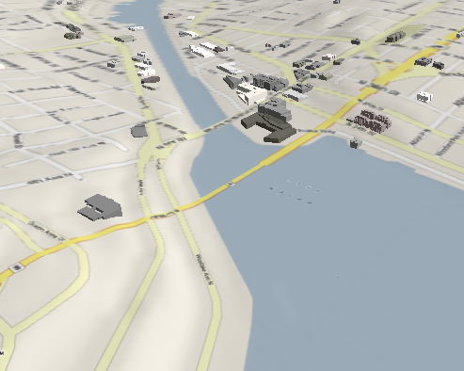
Location and General Linkages
Fremont
South Lake Union
Site
Site
Jones ◊ Rappe ◊ Chang Consulting, LLC
Notes:
In some cases, sites will be located in axial (i.e., linear) settings where potential users and/or customers are sparse in the immediate setting. As such, uses will depend on the ability to draw customers from remote locations as primary destinations via magnetic attraction, or entice drivers to stop in as they traverse the site on the way to another destination. Such situations can be attributable to landform as noted in the exhibits, as well as to ownership (e.g., government, tribal) which restricts development, or to natural (e.g., mountains, rivers) or manmade (e.g., highways, aqueducts) barriers.

Slide 24
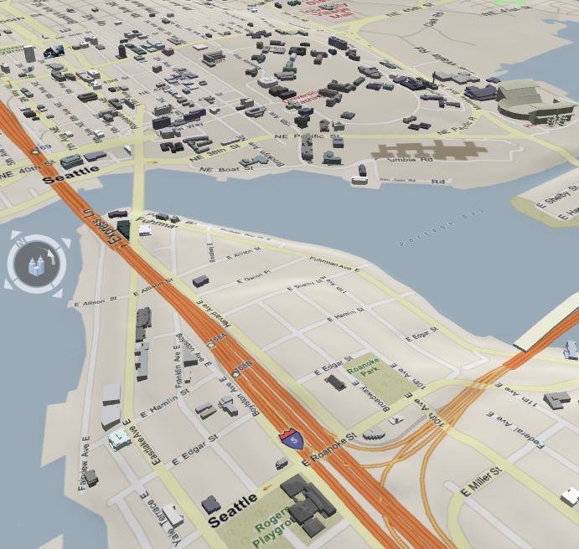
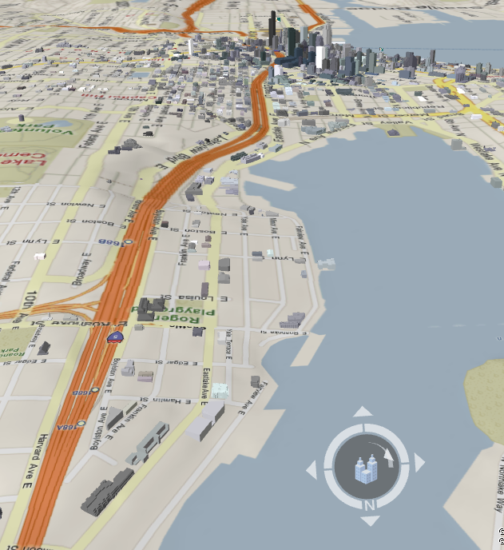
Linkages and Connectivity
University Village
Downtown Seattle
University of Washington
Capitol Hill
Queen Anne
UW Med Center/Husky Stadium
S. Lake Union
Project Site
Project Site
Easy vehicle, bus, bicycle access to University District via Eastlake Ave E.
Easy vehicle, bus, bicycle access to Downtown, Capitol Hill, S. Lake Union, Queen Anne.
Eastlake Ave: heavy traffic commuting between Downtown and U. District. 30,000 vehicle trips/day.
Notes:
In addition to discussing proximity and speed of connections, the discussion of linkages should point out some of the more qualitative dimensions of the linkage routes that affect the choice of connections and the likelihood they will be used. Examples of such variables include lighting, crime rates, maintenance of uses, types of uses, traffic levels, pedestrian corridors, bike paths and other attributes that affect the quality of the connections. This type of analysis is particularly important in cases where a site is on the fringe of a neighborhood, with the usage decision hinging on whether the developer can effectively link the site to the desired area, or whether it will be doomed to be in a different, and often less attractive and viable, sub-market.

Slide 25
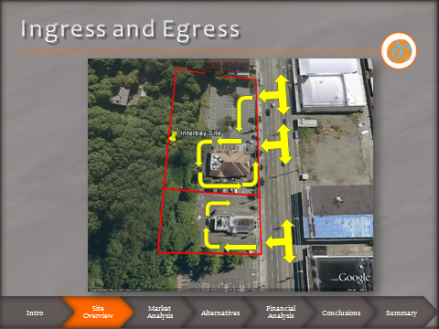
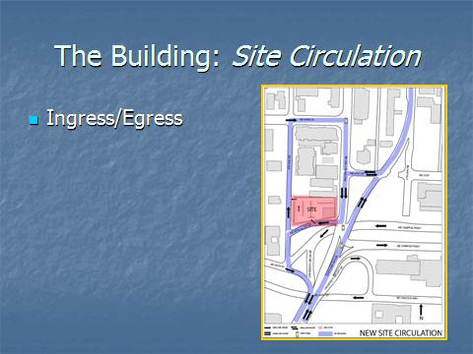
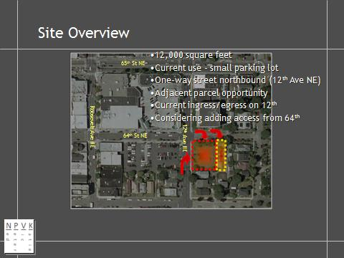
Micro-Linkages: Ingress/Egress
Notes:
Vehicular and pedestrian circulation routes in the immediate environs will be one of the key issues that affect the potential uses of many sites. In this analysis, special attention should be paid to major arterials and other "connections" that provide linkages to other sub-markets or to major transportation corridors. In addition to pointing out the corridors, the discussion should indicate the traffic flows within, and through, the neighborhood. With respect to pedestrians, the discussion should indicate street and sidewalk corridors, along with special walking paths and bike routes.
The site plan and other materials should indicate the general location with respect to surrounding land uses, streets and other connections, as well as the current ingress and egress points which provide access to the site. To the extent existing facilities are on the site which may be incorporated in future plans, the discussion should also point out the on-site circulation patterns, as well as parking, loading and other ancillary facilities or features.

Slide 26
Step 4: Legal-Political-Ethical Constraints
Legal-Political-Ethical Tie
  Constraints by law: Legal
    Site constraints
    Enterprise constraints (users)
  Constraints by Market
    Capital Market & Investor Constraints
    Community constraints
  Ethical/Political Constraints
    Sustainability and the irretrievable resource commitment
    Goodness of Fit
Dynamic Nature
  Many constraints are subject to change/negotiation
  Final binding constraints involve trade-offs of legal/political/ethical
For more info on implications, see: Case 1: Building Envelope Calculations.
Notes:
Analysis of Legal-Political-Ethical cover a range of external interventions or regulations ranging from entitlements which are constraints contained in local zoning and land use regulations to design approval which in some jurisdictions, empower local interest groups to weigh in on the design, intensity and nature of use. Since such factors constrain the options for a site, it is critical to review zoning and building envelope restrictions. The discussion should cover current zoning as well as plausible or possible zoning designations that might be achieve through appeals and/or litigation. If re-zoning is considered, analysis should point out implications of changes on maximum building envelopes or uses. The discussion should also cover other Government Restrictions including any use or use-intensity constraints that affect the site including blanket height restrictions, set-back requirements, and special designations (i.e., historic districts) that affect use or re-use of site. It should also address any government incentive programs that could affect usage or re-usage decisions, as well as private restrictions in the form of covenants, deed restrictions and easements that affect current use and potential re-use.
The ethical constraints address both the sustainability of the use, as well as the political palatability in terms of its acceptance by government and private bodies, as well as other stakeholders with a vested interest. While the emphasis should be on parties with standing and legal rights, it should also address community interests and preferences to help explain the context and consequences that might occur. Feasibility studies should also recognize that real estate decisions often entail and irretrievable commitment of scarce resources; as such, it is critical that we get it right. The ultimate criterion is the goodness-of-fit that we achieve between the users of space and the consumers of space, both at the micro and macro levels of aggregation, as well as current and future time periods.
On the dynamic side of the equation, this discussion is designed to give some insight into the probability of changing public usage controls or capturing incentives in the current legal/political climate. The importance of such a discussion will depend on whether the existing use and restrictions should be considered or if changes should be sought. The goal is to help quantify the likelihood, cost and timing of changes in light of potential opposition and support. In many jurisdictions, this public acceptance will be critical to success and, at a minimum, can have a significant impact on the timing of approvals.

Slide 27
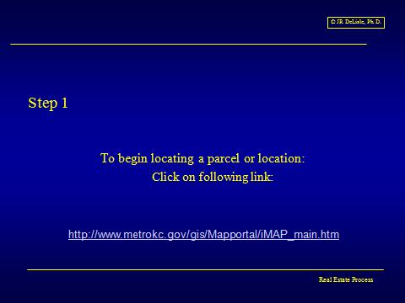
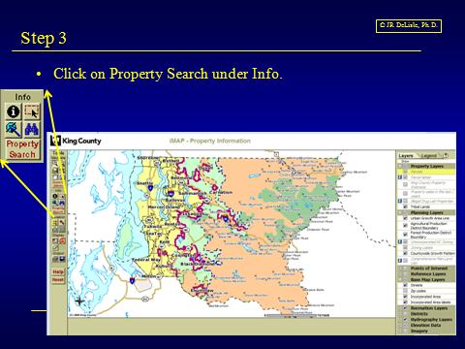
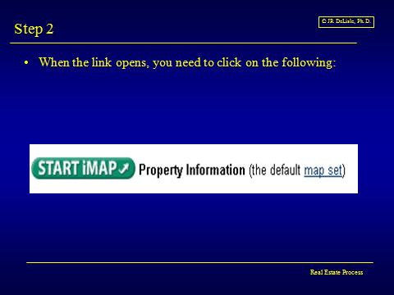
Parcel Data Search
http://www.metrokc.gov/gis/Mapportal/iMAP_main.htm#
For info on parcel data, see: Tutorial 2: Parcel Tutorial.
Notes:
In many jurisdictions, the determination of zoning status can typically be accessed via on-line sources and public records. In some cases, access to detailed site and neighborhood information is available on-line, including tax records, transaction prices and other publicly recorded documents. Since such data can be analyzed to understand market structure and succession, the analyst should explore data availability, as well as validity and reliability. The search of public records can identify interests associated with the parcel or parcels that comprise it, as well as other descriptive data that present a clear and unambiguous statement of the targeted real estate. At the same time, public records can reveal information on ownership and title, easements and private restrictions on use, and liabilities and clouds on the chain of title. In many assignments, the feasibility analyst will defer such findings to other but if so, still needs to address them by stating so in the statement of limiting conditions that are attached to the final report.

Slide 28
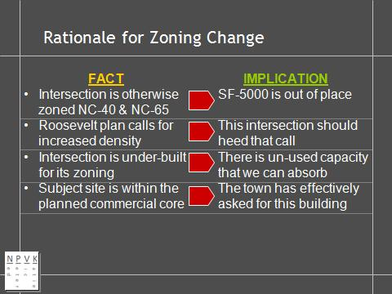
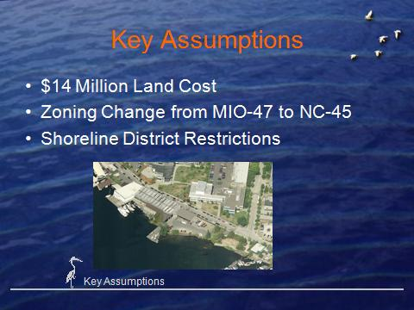
Change Rationale: Zoning, Traffic
Notes:
In some cases, current zoning designations may no longer be appropriate and subject to appeal. Thus, the analysis of the legal environment should cover current zoning as well as plausible or possible zoning designations that might be obtained through zoning appeals. If re-zoning is considered, analysis should point out implications of changes on maximum building envelopes or uses as well as the likelihood that the site could be re-zoned to a higher and better use.
The discussion should identify various stakeholders, to give some insight into the probability of changing public usage controls or capturing incentives in the current legal/political climate. The importance of such a discussion will depend on whether the existing use and restrictions should be considered or if changes should be sought. The goal is to help quantify the likelihood, cost and timing of changes in light of potential opposition and support.

Slide 29
Step 6: Trade Area Delineation
Micro: Region/City/Sub-market
  Spatial trends
    Community or regional growth, spatial skewing, scale and timing
    Structure: Sub-market relationship to broader economic base
  Economic Base
    Employment: composition, drivers, growth
    Elasticity: sensitivity of growth to economic conditions
Market Segments
  Current Market Segments
  Projected Growth by Market Segment
Notes:
In the context of real estate with its "fixed location," there are a number of distinct, but related, geographic definitions that are used in assessing the market context within which a particular site is situated. Indeed, one of the critical decisions that must be made in feasibility analysis is assigning the site to the neighborhood and/or submarket area. The delineation of such areas will depend on a number of factors ranging from legal and physical boundaries, to roads and highways and governmental boundaries. The ultimate delineation for each of these areas is something of a subjective process, drawing on such considerations as the nature of the site itself and the potential legal and marketable uses that can be accommodated o the site. In addition to being influenced by the particular site and its general orientation and logistics, delineation of appropriate geographic areas of interest will depend on general practices and perceptions held in the local market.
The delineation of trade areas should address market segmentation; the composition of occupants, residents or users of space. This analysis should be longitudinal, indicating current profiles as well as future profiles in light of likely changes or trends.

Slide 30
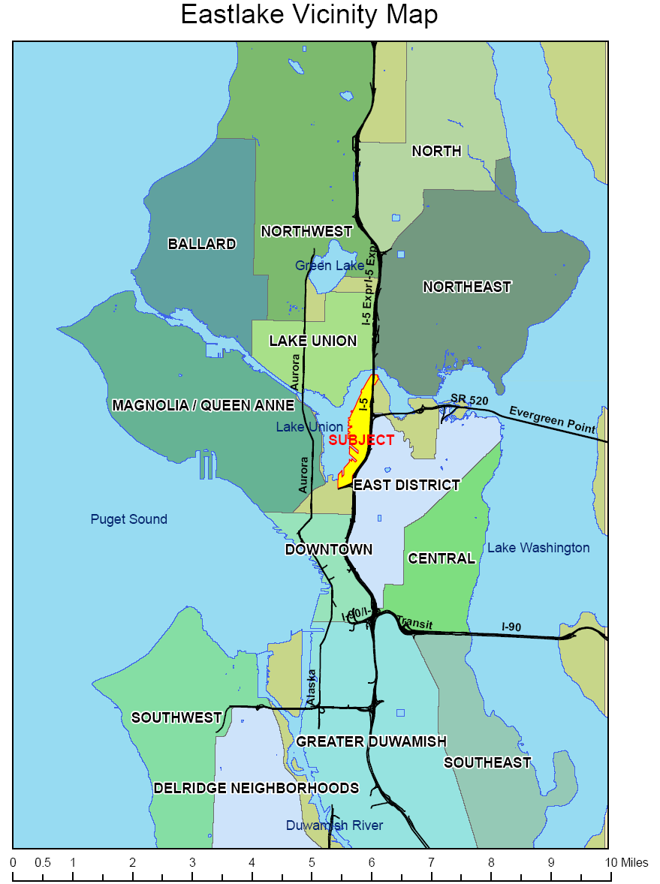
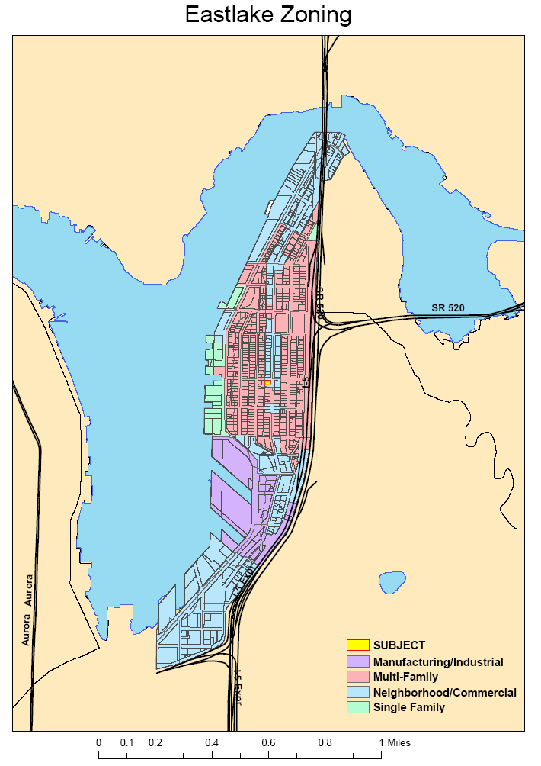
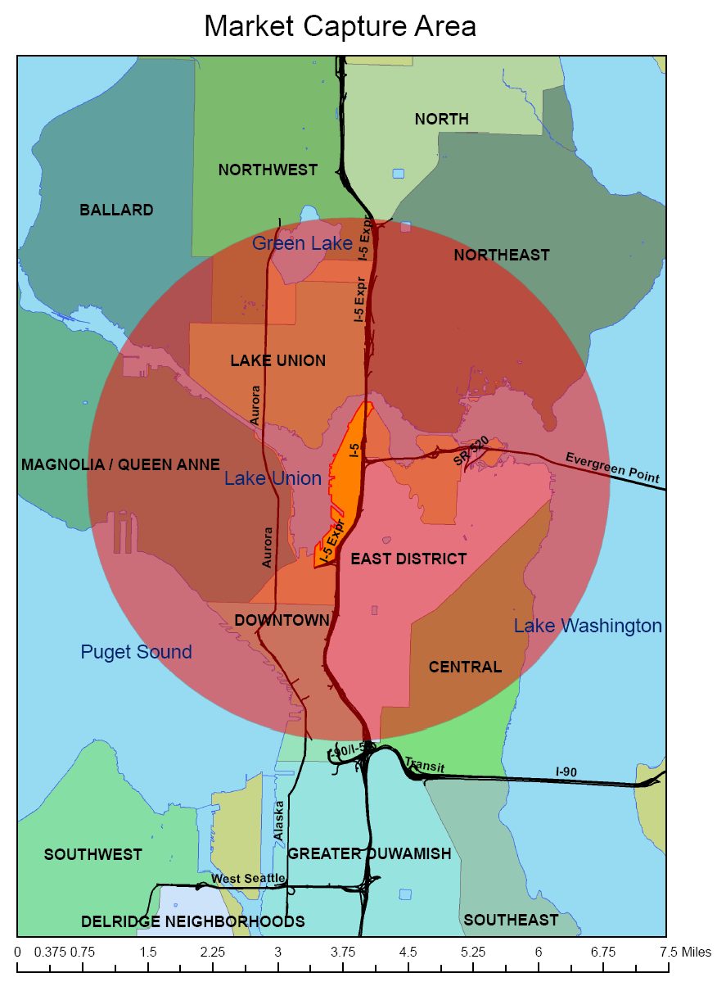
Trade Area Delineation: Rings are Out
Is this the Trade Area?
Notes:
One of the classical frameworks for trade area delineations is the use of concentric circles in 1, 3 and 10 mile (or other distance) increments. While having some appeal and relatively easy to aggregate block-level data, in many cases the use of such standardized geographies can provide misleading results. As noted in the exhibit, the use of a ring study would overstate the demographic profile and/or apparent demand for a site on Eastlake. Due to natural and manmade barriers, the vast majority of the area enfolded by the circle is not accessible to the site. Thus, such techniques should be used with a degree of caution and an understanding of local market fundamentals.

Slide 31
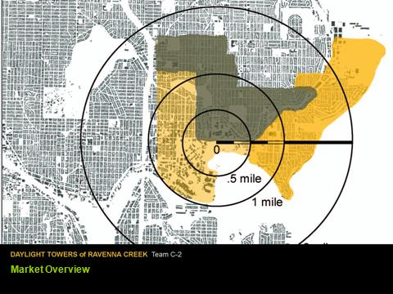
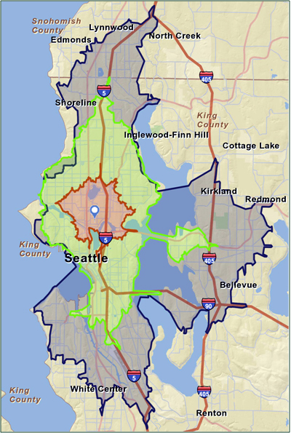
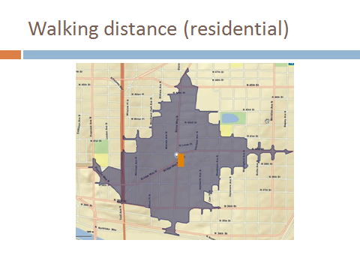
Trade Area Delineation
15 Minute drive
10 Minute drive
5 Minute drive
SITE
Notes:
The focus of neighborhoods and submarket delineation is to identify relevant geographic areas that provide the spatial context within which a site operates. On the other hand, the notion of "trade areas" focuses on the issue of marketability, of delineating the geographic area that will general the demand for goods and services that are offered on a particular site. Thus, the geographic scope of various trade areas will depends on the nature of use being considered for a particular site, and the nature of demand in terms of magnetism (i.e., drawing power) or convenience that determines the ultimate productivity for the use on the site.
Submarkets are based on some of the same premises as neighborhoods, although they tend to push the envelope outward a bit to enfold a broader area that has greater scale and diversity, but is still bound together by some common thread. With respect to commercial real estate, submarkets will often be delineated by national and local firms that track local real estate activity. In general, they are relatively broad geographic areas that have sufficient scale and activity to justify treatment as distinct areas (e.g., South Lake Union, South Seattle, the Eastside). Since analysis of real estate opportunities hinges on such data, these delineations can have a significant effect on how the real estate market views a particular site in terms of "comparable" data and should not be overlooked.

Slide 32
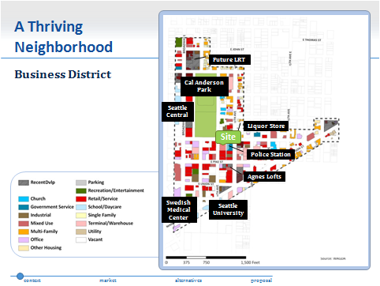
Step 7: Competitive Market & Demographics
Competitive Analysis
  Supply
  Mix/Pricing
Market trends and opportunity areas
  Aggregate data on local population, employment, income, etc.
  Industry trends relevant to the project
  Significant popular attitudes and trends in location market
Notes:
This discussion should provide a snapshot of competition in the surrounding neighborhood and/or submarket. This analysis should look at a number of physical usage and entitlement factors. In general, structural analysis will take a cross-sectional approach, exploring the current market structure. Relevant factors depend on he nature of use options, but will often address land use, land intensity, land values and other factors that deal with the space-time or money-time nature of real estate.

Slide 33
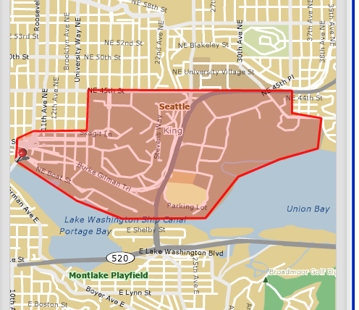
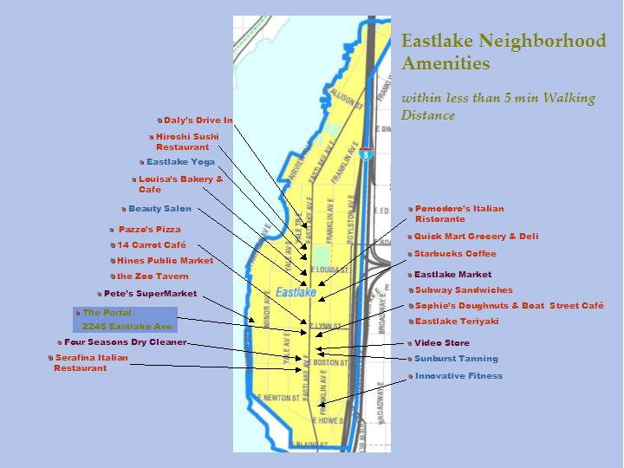
Delineate/Analyze Customized Area
To develop customized trade areas, see: Tutorial 4(b): STDBonline. or Business Analyst Online
Notes:
In general, the customized trade area for a site is defined as the geographic area that comprises the immediate environmental context within which the side is located. These neighborhoods are rather narrowly defined, focusing on proximity and a sense of identity. In some cases, neighborhood delineation is predicated on homogeneity of real estate, as well as commonalities in the demographic profile of residents or other space users. Linkages and connectivity are also major factors, including private and public transit as well as parking and general traffic circulation patterns. On the real estate front, factors that affect trade area designations include the type of land use, the intensity of use, the quality of construction, the level of maintenance and other physical descriptors that can be observed.
Several approaches can be used to provide an overview of competitive land uses in a customize area. First, a detailed map that is is color-coded or keyed to show land uses, either individual parcel, or general area. Second, a general map that shows land use by block or sub-area. Third, a table that provides summary data by block or sub-market to provide a profile or snapshot to the targeted area. In addition to property type uses, the analysis should also point out the quality and upkeep, to provide an accurate image of the general perception the market is likely to have with respect to the area. The analysis should also point out the intensity of use, helping explain the physical context within which the particular site is located.

Slide 34
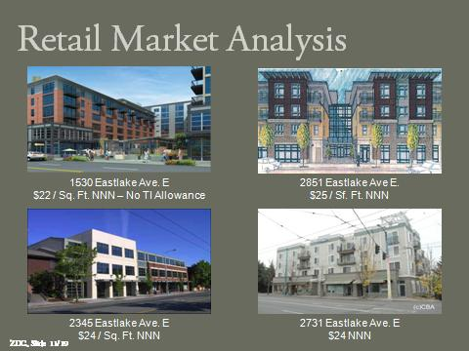
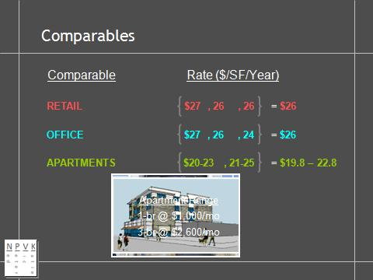
Competitive Analysis
To learn how to identify competitors and land uses, see: Tutorial 3: Reverse Directory.
Notes:
Competitive analysis can help quantify the supply side of the equation in terms of market rents, occupancy and market structure. In addition, the analysis can identify the potential for synergy across land uses that can be created within defined neighborhoods and submarkets. In essence, these synergies recognize the inter-use mix that can create a more balanced, self-sufficient submarket area. These effects recognize that certain activities trigger the demand for ancillary goods and services. For example, employment centers can benefit from, and help support, retail and restaurant activities. Similarly, retail and restaurant facilities can complement housing concentrations, creating more livable, walkable neighborhoods that have been emphasized in the "smart growth" movement. The concept of "agglomeration effects" extends the notion of inter-use synergies, suggesting that users can exploit untapped and underserved demand by identifying gaps in the balance of land uses. Once these gaps have been identified, tenants can experience "multiplier" effects as the addition of uses elevates the neighborhood to a new market plateau, increasing its collective trade area appeal.

Slide 35
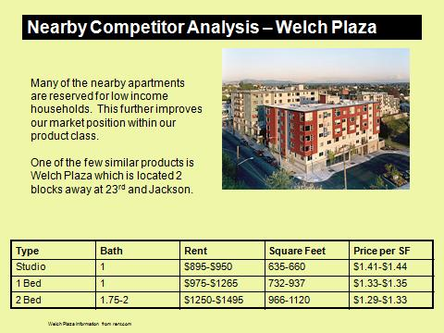


Market Analysis and Synergy
2006 Team F
Notes:
In a number of situations, market synergy can occur within land use categories as in the case of housing where residents develop as sense of identity and comfort by being surrounded by other residents who are either similar or compatible in lifestyle, demographics and behavior. Similarly, in the case of retail uses, the aggregation of complementary --albeit somewhat competitive-- uses can create a greater drawing power than achievable by an individual user. To the extent the retail function achieves such mass, the primary and secondary trade areas from which merchants can draw their support can be significantly expanded, increasing the market capture ratio for total retail sales or services.

Slide 36

Step 8: Alternative Uses/Users’ Profiles
Identify Preliminary Uses
  Major property types: retail, office, warehouse
  Secondary Property sub-types
Profile preliminary users
  Internal Analysis
    Entities & packets of functions
    Drivers of Value
    Trends & Life cycle stage
  Real Estate Elements
    Spatial needs & internal vs. external orientation
    Approach to real estate solutions
For a guide to free demographic data, see: Tutorial 4(a): Easi-Demographics.
Notes:
While this can be compressed to a summary table or two, the report should indicate the alternative uses that were considered, but rejected in favor of the recommended use. This discussion will be important to a determination of the rationale behind the decision or recommendation and the unique, market and submarket assumptions that affect the recommended solution.

Slide 37




Target Market

Slide 38


Target Market Analyis

Slide 39



In the End, It’s All About the Numbers
2006 Team E2
For more info on making numbers “easy to crunch,” see: Case 3: Frontdoor/Backdoor Analysis.
Notes:
This analysis should provide fairly detailed financial analysis of the recommended solution. Despite this precision, the exhibit in the body may be summary in nature, with reference to a more complete set of documents that are more appropriately presented in the addendum. The underlying assumptions should be clear and should be focused on the specific project. In most cases, feasibility studies will contain formal discounted cash flow analysis to indicate the pro forma performance that is expected for the recommended investment or action.

Slide 40


Step 9: Alternative Uses and Scenarios
For more info, see: The Interactive Design-Marketing Model in Determining Highest and Best Use
Notes:
Once the viable alternative uses have been identified, the analyst can explore alternative scenarios. In this phase, the leading competing uses can be expanded into a more detailed analysis of specific uses (e.g., retail can be stratified into convenience or magnet categories, while office can be divided into subset based on the type of activity or use, and the nature of the activity; whether its front office space with high image value or back office space with emphasis on price).

Slide 41




Design Concepts
2006 Team C1
2006 Team A2
2006 Team B1
Notes:
To provide a sense of scale and design, this exhibit or series of exhibits should present the general design for the recommended solution, indicating the scale and visual image of the proposed use/development. The appropriate level of detail will vary by assignment although the exhibit(s) should provide a visual representation of the proposed use.

Slide 42


Alternative Use: Numbers and More Numbers
2006 Team C1
To get your costs in line, see: Case 2: Total Replacement Cost Analysis.
Notes:
While the analysis of “Most Fitting Use” transcends numbers, the capital intensive nature of real estate demands that numbers be incorporated in the alternative use decisions. These exhibits should provide a brief synopsis of the financial analysis of alternative proposals that were considered in the analysis of alternative uses. The analysis will be sufficiently detailed to support preliminary conclusions regarding the viability of selected uses from an investment perspective, but will be based on relatively generic market assumptions relative to the major property types that are legally permissible.

Slide 43


Most Fitting Use: An Integrated Approach
For more info, see: Case 6: Most Fitting Use.
Notes:
One of the first stages in assessing Most Fitting Use is to rate the site against the evaluative criteria of the potential users to determine the “Most Suitable Use.” In this case, the analysis adopts a generic user profile for the major property categories, and then compares those criteria against the full dimensionality of the subject property: static, environmental and linkage attributes. As noted in this exhibit, the actual profile of the site generated in previous analysis is evaluated against the standards for the potential uses.
Once the analyst has explored the "fit" of the site with potential users, the analysis can be expanded to address the “Politically Palatable Use.” This use addresses the concerns of other constituencies or stakeholders who are focused on the broader community. Using this broader approach, the analyst can solve for the optimal use that provides the best overall, aggregate fit among the site, users, investors and community players. As noted in this exhibit, the community may have different preferences for the use of a particular site or district, seeking to obtain greater urban efficiencies and improve the overall harmony and quality of life it affords its residents.
In determining the “Highest and Best Use,” the maximization of land value is added to the traditional feasibility criteria to compare alternatives. This expansion recognizes the fact that different uses have different return potentials and, at the same time, may entail different risks. The impact of adding "land residual" calculations to the equation is typically used to identify the use with the highest surplus value after the costs of production are deducted. Regardless of how the H&B Use scores are derived, it is also useful to look at attribution analysis to identify the key assumptions and factors that contributed to the ultimate rating.
Unlike the traditional feasibility tests and the Highest & Best Use analysis, the determination of "Most Fitting Use" involves exploring the actual product (e.g., static, environmental and linkages) construct against the spatial needs of potential tenants and space users. This analysis can also be extended to look at how well the use alternatives address broader community issues in terms of economic base, tax base and other community-level factors.

Slide 44



Alternative Use Recommendation
Notes:
In some cases, a client will approach a feasibility analyst with a preconceived notion of what should be done. This situation will create a challenge, since these preliminary notions have not benefited from the rigorous analysis envisioned in the typical scope of services for feasibility studies. While some assignments may be properly narrowed in scope, such limitations must be clearly indicated in the "Limiting Conditions" section of the report to protect the analyst's professional reputation and ensure the study is not used for purposes beyond those for which it was intended. In general, feasibility analysis should not be unduly constrained by such a priori expectations at the risk of becoming “feesibility studies.” Thus, it is important to consider alternatives even if the goal is to help quantify the cost/benefit of the pre-specified use relative to the alternatives that could be pursued.
In the "site in search of a use" problem, the analysis will typically include several phases of filtering. In the first phase, the analyst will test alternative property type uses against the site, market and neighborhood analysis. The objective is to determine which broad class of uses (e.g., office, retail, residential, industrial, hotel --or some combination thereof-- has the "best fit" with the real estate itself. This analysis adopts the potential space users' perspective, trying to identify the uses that would most value or benefit from the amenity package the real estate represents. To support this determination, the analyst must develop sufficient empathy with potential users to be able to identify, and prioritize, the the criteria they apply in selecting real estate. While this might appear to be something of a stretch since the economics have not yet been calculated, by looking at the question from the space user's perspective one can help ensure a more optimal solution that will have an enduring value.

Slide 45



Step 10: Final Use Specification & Packaging
Notes:
Once the final use decision has been made, the details must be flushed out and refined for final presentation. If the analysis has followed a logical pattern, this phase can draw on the foundation that has been laid in the previous steps. At this point, the analysis can pay greater attention to details, firming up the design and financial analysis. This assembly process will help ensure that the final package is adequate to support the final recommendation and ensure that no “deal breakers” have been overlooked.

Slide 46



Final Design and Financials
For info on fine-tuning DCF, see: Case 5: Discounted Cash Flow Analysis.
Notes:
The final details can be worked out at this point, with the focus on ensuring the recommendation has been fully vetted and the numbers make sense. To avoid getting lost in details of design or financial analysis, the results can be presented at a summary level, with additional backup materials to support individual components.

Slide 47




Implementation Timeline, Risk Mgmt. and Marketing
Notes:
While many feasibility studies stop short of the execution stage, the likelihood of achieving success will be enhanced if the implementation and marketing phases are addressed to ensure a proper execution of the recommendation. This analysis will also benefit from a discussion of the critical success factors which must be adhered to during the development and operating periods to ensure the project is sustainable.
The analysis should also identify the major risks and risk management program necessary to avoid excessive risk exposures that could jeopardize the success of the project. The objective is not to eliminate all risks, but to ensure they have been identified, quantified and priced into the decision. In some cases, the risk/reward equation will not justify a project. In those cases, attention should be paid to the deal breakers and what, if anything, can be done to resolve them by the client. Alternatively they can identify the changes that would have to occur to neutralize them as a result of externalities or contingencies that might occur.

Slide 48



Exit Strategy and Conclusion
Notes:
The final stage in feasibility analysis is to identify the exit strategies that have been factored into the analysis to ensure the full temporal spectrum of the real estate life cycle is address. The conclusion should also present a checklist or synopsis of the project in terms of how it satisfied the goals and objectives that were outlined in the problem statement. In the event a project is deemed not feasible, the conclusion should indicate the deal points as well as any steps that could be taken to overcome them.

