Slide 1
Economic, Capital and Real Estate Outlook 2010 presented to:
IREM 2010 Forecast by: Jim DeLisle, Ph.D.
December 4, 2009
jrdelisle@jrdelisle.com
Notes:
This is an annotated copy of the keynote presentation I made on December 4, 2009 to the attendees at IREM’s Real Estate Outlook annual Fall Conference. In addition to materials on the national economy, capital markets and real estate markets, the presentation incorporates responses to a new survey of attendees, as well as insights on the Seattle/Puget Sound real estate market. This was a compressed presentation which was intended to set the stage for the panel discussion which was the focus of the meeting. For a more in-depth discussion of the current market, viewers are referred to the presentation I made at the Seattle Chapter of the Appraisal Institute on December 1, 2009 which can be accessed from my personal website: http://jrdelisle.com

Slide 2
Presentation Overview
  I: Outlook 2010 Prelude
  II: Economic and Capital Markets
  III: Real Estate Capital Markets
  IV: Commercial Real Estate Market Update
  V: Implications for Seattle Real Estate Market
Notes:
In this presentation I will start with a brief overview of the current state of capital and real estate markets, along with a preview of the major topics I will cover. The initial topic explores some of the underlying factors that led to the current crisis. From there we discuss the economy and capital markets along with the commercial real estate market. We conclude with a discussion of the implications for real estate professionals, with added insight gleaned from a survey of the audience prior to the meeting.

Slide 3
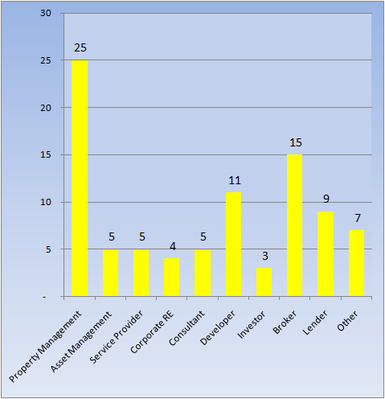
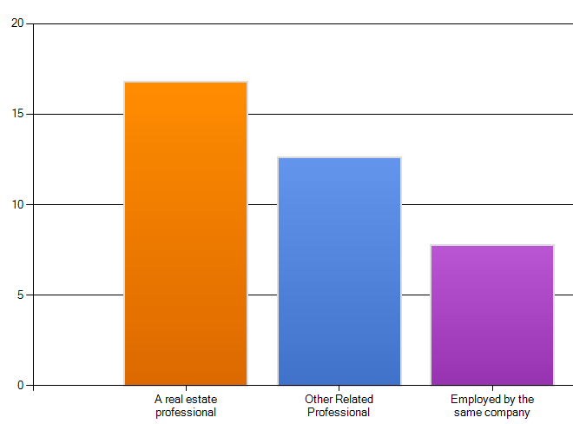
Who Responded to the Survey?
What Specializations?
Experience of Respondents
Real Estate Professional
Other
Same
Company
JRD Prediction
Number with Same Company will decline…..
Sources: JRDeLisle, IREM Survey Respondents
Notes:
A brief Internet survey was conducted to engage the audience and get them thinking about the issues. The survey received over submissions which translated to more than a 50% response rate. While the responses were anonymous, they respondents were asked to indicate the number of years in the real estate or related professions, as well as the number of years they worked for their current employer. As noted, the respondents were fairly senior with over 15 years on average in the real estate industry.
Many respondents had been with their current employer for some time, with the average number of years with the same firm around 14 years. I predicted that this ratio will come down over the next five years as some drop out and opt for retirement, while others will see their companies implode and close their doors as the downturn sets in even more than it has to this point.

Slide 4
What Issues Concern You the Most?
Real Estate Cycle
  When will this all be over?
  What challenges/risks do we face?
  How act with government wildcard?
Mortgages/Debt
  What is the solution to the financing/debt problem?
  Why won't lenders loosen up?
  What's up with lenders?
Seattle Real Estate Market
  Will meltdown hit Seattle?
  Will we see distressed asset sales?
  What's the outlook for leasing/sales?
  How can we avoid rent decline?
Seattle/Regional Destiny
  How can we be more business friendly?
  How can we lure tenants downtown?
  How can we strengthen local economy?
  Where will next wave of tenants come from and how get them here?
Sources: JRDeLisle, IREM Survey Respondents
Notes:
To help set the stage, I presented the four major categories of issues that concerned the respondents. These included: the cycle and when we would hit bottom and how steep the fall would be; the commercial mortgage market and how to solve the impending crisis; whether Seattle would experience the national trends; and, what we can do to control our own destiny.

Slide 5
Part 1 Prelude: Three Major Attributes of Real Estate
Three major attributes of real estate . . .
  L,
  L,
  L.
Three major attributes of real estate . . .
  L,
  L,
  L.
L
  . . . . . . . ulnerable,
  . . . . . . . ulnerable,
  . . . . . . . ulnerable.
L
L
The 2009 regime of real estate . . .
  D
  D
  D
  . . . . . . . istressed,
  . . . . . . . istressed,
  . . . . . . . istressed.
The 2010 + regime of real estate . . .
L, L, L
Butt, what the “L”?
Liability, Litigation, Liquidity (NOT!)
Notes:
This slide is designed to disarm the audience a bit and get them thinking creatively and out of the box. The play on the Location, Location, Location theme points to the Vulnerability of real estate due to the potential impact of a range of externalities. It also introduces the “D” word for distress. We also talked about the dreaded “R” word which to some might be “Recession” but to developers is “Recourse” which is coming in future loans resets which are hanging over the industry.
In something of a return to fundamentals, the L, L, L is back in vogue for 2010. Unfortunately, instead of Location, Location, Location, they will stand for Liability (recourse for borrowers), Litigation for a lot of players, and Liquidity (NOT) reflecting the inability to access debt capital and the challenges sellers will face when the glut of distressed assets clouds the market.

Slide 6
Commercial Real Estate: How we Got Here
Foreign $’s
Pension $’s
Record Const.
Total Return
9/11
Recession
Value Change
ERISA
CMBS
NCREIF
Tax Reform
UPREITs
Defensive
Capital $’s
Tax Reform
RE Collapse
Deregulate Fin Inst.
Tax Recovery: ACRS
Thrifts Collapse
RTC
Notes:
In order to understand the impending crisis facing the commercial real estate industry is useful to take a historical look in to see if we can extract the lessons learned from the past. The seeds for institutional real estate investment were planted with the passage of ERISA in 1974. The most significant impact of the legislation was to raise the prudent man criterion to prudent expert criterion. Under the prudent man criterion, institutional investors to avoid real estate as a risk management tool based on its inherent complexity. However, under the prudent expert criterion, if real estate was an asset class, institutional investors and asset allocators were required to commit resources to achieve diversification. By 1978, institutional capital flows to real estate were still limited, due in large part to the absence of the return is series of asset allocators could use to understand how real estate with other asset classes. To address that need the real estate units of the major life insurance companies including Prudential, Aetna, Cigna and Equitable created the National Council of Real Estate Investment Fiduciaries (NCREIF). The objective of NCREIF was to create a time series for real estate returns that asset allocators could use along with stocks, bonds and other asset classes in making asset allocation decisions.
In 1981, financial institutions were deregulated and allowed to create development subsidiaries. In 1982 the Economic Tax Recovery Act (ERTA) creating double declining depreciation was passed. This attracted more capital for syndicators, who doubled up with foreign investors and pension funds to create a surge of capital to real estate. This created a disconnect between the spatial and capital markets. This led to overbuilding which ultimately led to the collapse of latter 80s. Other than disposing of troubled assets, the real estate market shut down. When the commercial real estate market collapsed, the RTC was created to work off that debt financial institutions. In 1994 faced with the prospect of filing bankruptcy, Taubman decided to file an IPO and convert to a REIT and was quickly joined by a spate of other owner/developers including Simon, DeBartelo, General Growth and a number of smaller players. Around the same time, while the RTC was wrapping up its business, Wall Street investment banks and others sought to convert the temporary securitization of commercial real estate to an ongoing activity. During the mid-to latter 90s REITs grew from under a $10 billion industry to over $200 billion, while CMBS volume rose from nothing to a similar market cap.
Our success in recapitalizing the real estate market was quickly adopted across the globe, setting the stage for the worldwide collapse of credit and real estate markets that is now occurring. In 2001, the 9/11 tragedy attracted investors to real assets are real estate --and other real assets-- were seen as defensive investments. Benefiting from an improving economy and the government’s support of homeownership for all and complete trust in self-control by financial institutions, the housing market went on a bull run characterized by easy credit. Thus, both the commercial and residential markets became disconnected from the fundamentals (i.e., Wall Street vs. Main Street or Capital Markets vs. Spatial Markets). This disconnect led to the recent collapse since easy created permeated all asset classes and became an accepted mode of operation. Unfortunately, the problems in the commercial market have yet to be recognized with attention being focused on the residential market and the broader credit markets. The disconnect that occurred on the commercial side that has yet to receive attention suggests hard times ahead.

Slide 7
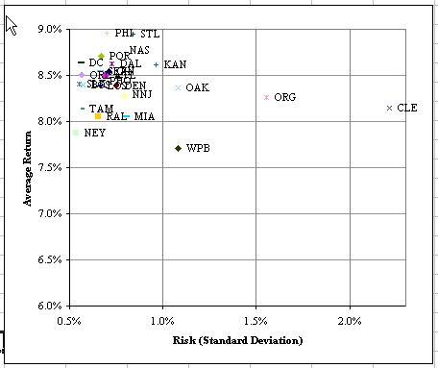
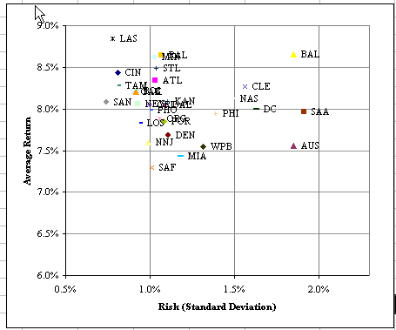
What Happened: Commoditization of Pricing
Market Risk/Return Long-Term
Recent: Risk/Return 5 yrs
Notes:
One of the buy-products of the disconnect between spatial and capital markets was the trend toward commoditized pricing. This term refers to the fact that investors --and indirect capital providers-- failed to price risk associated with property types and markets. As such, prices converged from historical levels. This is illustrated by comparing the long-term risk/return plots by market with the more recent risk/return plots stemming back some 5 years. As noted, markets were drawn into a narrow band due in large part to surplus capital flows. Going forward, returns are expected to diverge or move to longer terms levels along with the attendant risk. Respondents to the survey were somewhat divided on the question of whether commoditized pricing is behind us, with a slight majority believing that fundamentals would once again prevail as investors focused on the risk side of the equation. If this occurs --as I believe it will-- 2nd and 3rd tier markets with limited exit strategies will fact particular challenges, as will weaker product which in the recent past benefited from the rising tide of values. On the other hand, there will be opportunities for those who can pick and time markets --which is possible in real estate-- as well as those with an understanding of fundamentals and the ability to “Create value.”

Slide 8

The Three C’s of our Disconnect
Credit Crisis
  Easy Credit
  Cheap Credit
  Plentiful Credit
Crisis of Confidence
  Consumer Confidence
  Corporate Confidence
Crisis of Collateral
  Value attributable to delinking spatial market/capital market
  Values correction as “marked to market”
  Re-pricing of Risk
Notes:
We are facing an unprecedented confluence seemingly independent, but related events. The problems began to surface in the residential credit markets. Once attention was drawn on festering problems in the residential market, some began to worry about whether this was a symptom of a broader problem. Those who began to explore how widespread the credit practices were in other sectors, realized that we had created a house of cards. As attention turned to the broader economy, the credit crisis quickly turned into a crisis of confidence. The crisis of confidence was contagious, rippling across the consumer and corporate spectrum forcing many players to revisit expenditure patterns. Once confidence levels were eroded, the market faced the double-whammy of tightening or evaporating credit. This quickly translated to an erosion in collateral values, leading to a self-fulfilling prophecy which became a black hole that started the implosion.

Slide 9
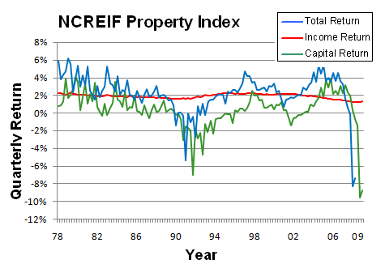
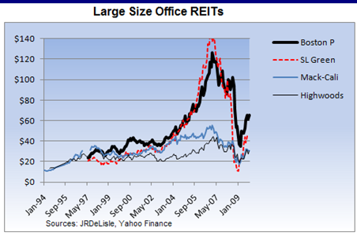
How We’re Doing: Institutional Real Estate
Private Equity
The Good News….
It’s not as bad as it was
REITs Bouncing?
Public Equity
Sources: JRDeLisle, NCREIF, NAREIT
Notes:
In addition to opportunity funds, core institutional real estate has take a major hit. According to NCREIF data, values have fallen some 35% or so. Unfortunately, more losses are ahead as cap rates rise and NOI deteriorates even more. The good news –glass is half full- view suggests the rate of losses is slowing down. While true, the implicit cap rate is still too low suggesting more adjustments are coming. Furthermore, the 3=10 year numbers are so weak they call into question the assumption of continued allocations to the asset class, especially since it will likely lag other asset classes on the recovery side.

Slide 10



Part II: A Growing Consensus on Economy
Sources: JRDeLisle, IREM Survey Respondents
Notes:
To get some local insights into the national economy, respondents were asked to agree or disagree with a series of questions focused on the economy and economic cycle. Although most respondents see the economy turning –a validation of the timing question– they recognize it will be gradual and carry into next year. The continuation of low interest rates will be critical, as will a return to normalcy in the credit markets. Unfortunately, the credit markets will be a major wildcard, with most seeing the problem stretching well into 2010. That would set the stage for a colision with the surge in commercial mortgage refinancing activity and likely surge in distressed asset sales.

Slide 11
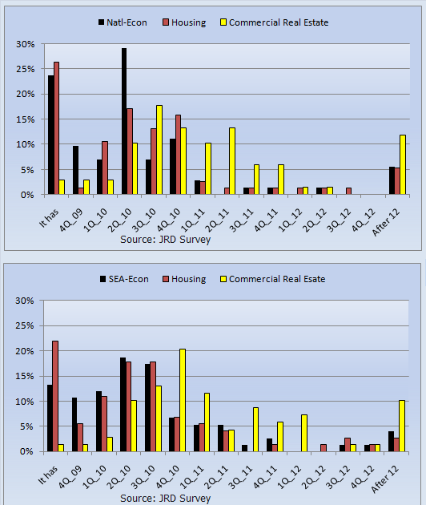
When National & Seattle Markets Bottom Out?
National
Seattle
Sources: JRDeLisle, IREM Survey Respondents
Notes:
To get a general sense of where we are in the cycle, respondents were asked to indicate the timing of a bottoming out for the economy, housing market and commercial real estate market. These questions addressed the overall national markets, as well as the local Seattle/Puget sound market. As noted, many thought the economy had already turned or would in the 4th quarter. The opinions on the housing market were much more divided, with responses ranging from it already has to the fourth quarter of 2010. As to the commercial real estate market, the bottom is at least a year or more off; a position I also hold.

Slide 12

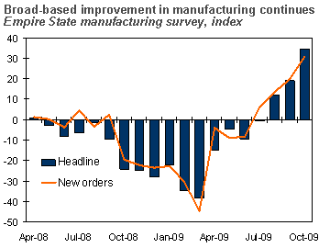


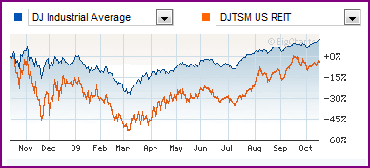
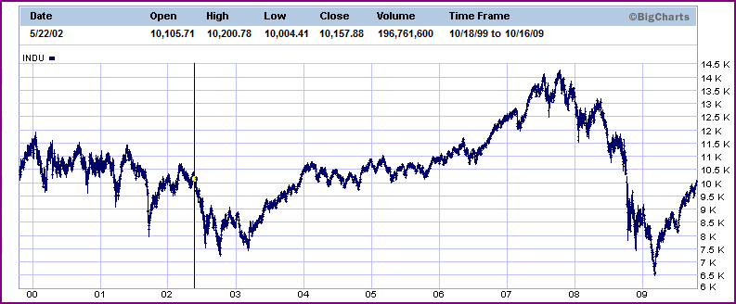
Breaking News on Real Estate & the Economy
Notes:
There has been some good news, with GDP expected to turn positive in the 4th quarter although any recovery is going to be tempered. The stock market is certainly poised for a recovery, with investors anxious to regain some lost ground. The outlook for the construction industry is based in part on recovery in the housing market which is likely to disappoint many unless the tax credit program is extended and employers start adding jobs. On the other hand, stimulus backed spending on infrastructure is likely to provide some ballast for the sector. The excess capacity built into the current commercial market will make that a lagging sector when the economy does recover.

Slide 13
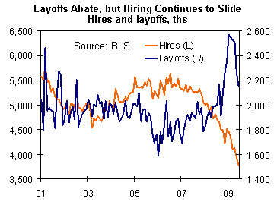
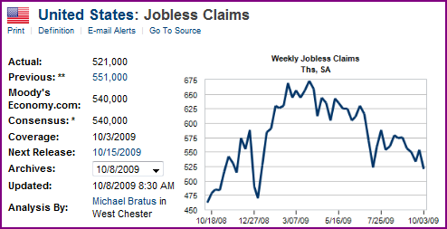
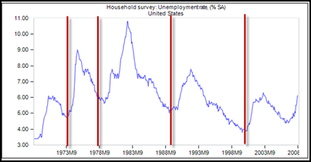
The Good News: Employment Losses Slowing
Net Employment losses
Jobless Claims Slowing?
10%
Unemployment
Source: economy.com
Notes:
One of the key challenges to the US economy is the softening in employment and rising unemployment levels. We asked the audience if they agreed or disagreed with the statement that employment was set to improve in early 2009. Some 93% of respondents indicated no, suggesting they anticipate weakness on the job front to continue. In order to help with the unemployment figures in context, it is useful to look at unemployment levels in the prior recessions. As noted in the graph in the upper left of the slide, unemployment levels in the 70s early 80s and early 90s were much higher than the current levels.
Given the weakness of the US economy compared to those times and the prospects of further erosion, unemployment rates are likely to remain sticky around the 10% hurdle. Whether they will break into double digit levels will depend a lot on how the economy settles down and how recent and future government interventions work. Over the near term, conditions are likely to erode even further with weakness across most sectors including state and local governments whose budgets are getting hit hard. Thus, the lack of employment growth is expected to continue to put a damper on the economy and consumer confidence.

Slide 14

Critical Elements to Sustainable Recovery
The Future Remains Uncertain
Sources: JRDeLisle, IREM Survey Respondents
Notes:
This slide presents the responses to a series of questions soliciting the relative importance of various factors to a sustainable economic recovery. In addition to the insight shared by individual questions, the real message is in the fact that most are “Very” or “Important.” This suggests the stars have to stay in line and there are few degrees of freedom should the economy stumble. As might be expected, job growth rather than slowing losses is the most critical factor.
Interestingly, the lowest scores were for continuation of federal stimulus programs which may well be more a function of the relative lack of success they have achieved and frustration among taxpayers who realize someone will ultimately have to pay the piper.

Slide 15
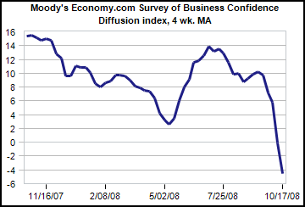
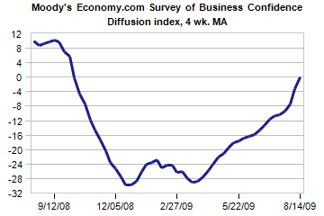
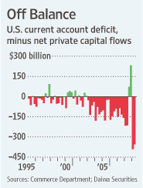
Business Confidence
U.S. Business Confidence
Some improvement….
But, deficit….
9/12/08
9/12/09
Source: economy.com
Notes:
Business confidence remains weak in with respect to hiring and expansion planning. Unfortunately, businesses aren’t receiving the same attention as households in terms of assistance with the exception of financial institutions and the auto industry. With credit tight, pessimism will likely pervade the near-term outlooks even more than in the recent past.
The situation is clearly global, with confidence levels down in most developed nations. Emerging markets are struggling even more than “normal” in the tight credit environment although spreads have eased a bit. The deficit remains a concern, especially with exports languishing in spite of the cheap dollar.

Slide 16
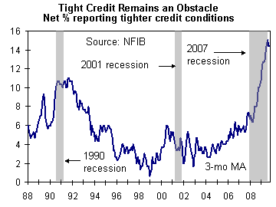
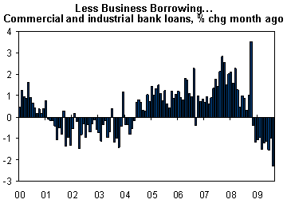
Focus on Small Business
Credit Remains Tight for Business
Small business report tighter credit
Reactions
  Cutting payrolls
  Reducing inventory
  Reducing capital spending
Outlook
  No near-term improvement
Source: economy.com
Notes:
Although there have been some positive signs on the business front, the situation in which many small businesses find themselves is still dire. After experiencing tight credit noted in the upper right graph, businesses began to cut back on payrolls, inventory and spending. As such, business borrowing has actually declined. This situation can be explained in part by the tight credit, as well as tempered outlooks. Unfortunately, with small businesses a critical factor in job growth, these cutbacks do not bode well for the recovery until they turn the corner.
The tight credit markets are likely to continue with record levels of commercial debt and mortgages coming due over the next 2-3 years. Until the banks and other sources of credit loosen up, smaller businesses will continue to be on the defensive.

Slide 17
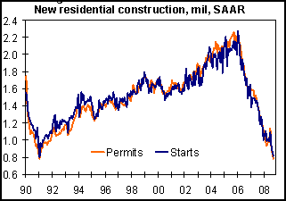
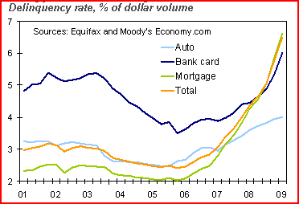
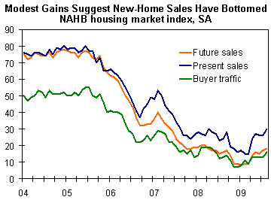
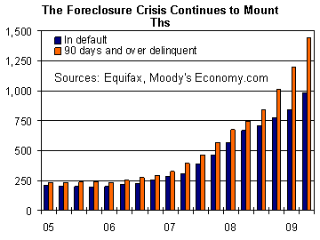
Housing Activity and Delinquency Rates
Construction
Delinquency & Default
Housing Index
Residential Foreclosures
Notes:
The housing market is in a somewhat tenuous state, with some buyers being drawn back into the market due in part to the first-time homebuyer credits. Although there is a lot of positive rhetoric about it being time to get off the fence, there are few signs that the market has fully bottomed out. Housing permits and starts have picked up a bit after plummeting to the lowest level in over 20 years. While inventories have been declining, sales levels and traffic remain low as potential buyers wait for the economy to improve.
In a number of overheated markets, raw land values have already plummeted by 60-70% from their 2006 peak levels. Delinquency rates continue to rise at an accelerating pace, spreading across the country as the consequences of easy credit hit home. In the absence of meaningful intervention, this trend is likely to continue, especially with estimates that some 30% of households who bought in the last five years are underwater, the principal balances greater than market values. At this point, some reminisce about the “It’ll be fine in 2009,” and are now resigned to “But then again, it could be 2010.” Unfortunately, those timetables may be realistic, depending on how long it takes the market to bottom out and capital to return to the sector.

Slide 18
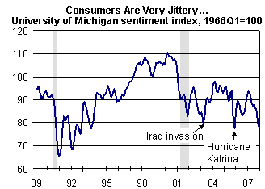
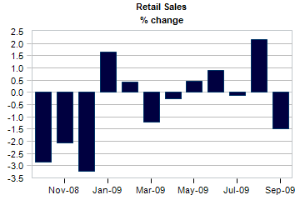
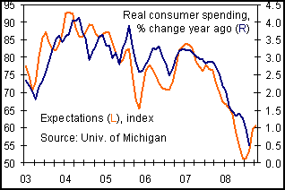
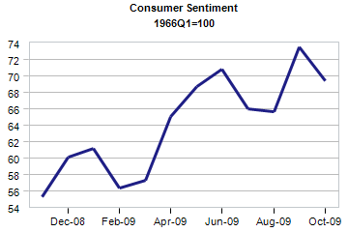

Consumer Confidence, Spending & Credit
Consumers Contracting
Consumers are over 70% of GDP….
Source: economy.com
As of October 2009, recent uptick in retail sales on Year over Year; partly weak 2008…
Butt…
Notes:
Since they are consumers themselves, the respondents provided some interesting insights into the prospects for consumer spending. Some 80% strongly agree or agree that consumers will continue to contract expenditures. This anticipated decline is noted by the high correlation between confidence levels and consumer spending; both of which are expected to continue to struggle. More recently, consumers have cut back on installment credit which might be taken as a good sign, although it is more likely due to the pressure of mortgage debt and the desire to hunker down in order to hang onto their houses and make it through the rough times they see ahead. Given how households are being squeezed in terms of budgets, it is unlikely that savings rates will move back into positive territory, especially as consumers have little confidence in the stock market.
It is well known that the US is a consumer led economy. Indeed, with the slowdown on the business side of the equation, retail drives over 70% of GDP. The recent numbers show some improvement, with October 2009 sales up vs. year ago figures; unfortunately, they were so bad last year this improvement is not very meaningful. Also, once the car clunker program expired, retail sales contracted as might be expected in light of the tough economy and continued job losses.

Slide 19
Part II Summary: The Economy
Macro-economic Environment
Economy showing some signs of turning
Businesses struggling, credit tight
Consumers bearish
Notes:
In looking at the snapshot of the spatial market --supply and demand for real estate-- the bottom line echoes that of the broader economy and capital markets. That is, there is some additional downside risk associated with a combination of a slowing economy, tighter credit, a renewed interest in risk, and weakening fundamentals. That situation should prevail over the near-intermediate term, with commercial real estate lagging the broader economic recovery which is well into 2009 at best. These will be interesting and challenging times with some opportunities for those willing and able to take advantage of the market malaise and lack of capital.

Slide 20
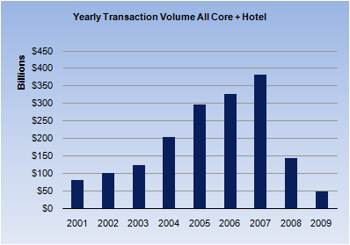
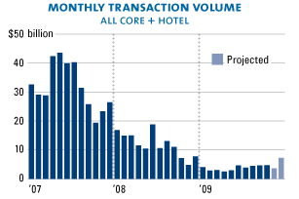
Part III: Real Estate & Capital Markets
Investment Preferences
  Core assets at distressed prices
  Major markets, strong assets
Timing
  Still waiting for bottom
  Indecisive; slower to act
Transaction Volume
Decreased capital flows
  Investors still frozen
  Debt limited sources & tighter
  Access & yield for equity
Capital Market Challenges
  Refinancing: volume & status
  Surge in distressed assets
  Mark-to-market risks
  Growing pressure to act..
Sources: JRDeLisle, RCAnalytics
Notes:
With respect to institutional capital flows, a number of trends create downside risk for the commercial sector. First, capital flows will decline, both from domestic and international sources distracted by credit crises sweeping the globe. Second, investors will search for value and eschew risk, looking a simpler structures and products. Third, investors will be patient and wait for signs the market is bottoming out; they will be indecisive and slower to act, especially those lacking a firm understanding of real estate fundamentals. While this capital environment will create problems for many, it does offer some opportunities. In general, cash will be king, especially if it is mobilized and can act in a preemptive manner as sellers and holders panic or are forced to action.
A good source of product for such investors will be “channel sourcing” or looking at REO, TICs and highly leveraged buyers with limited ability to refinance who will begin to recognize their plight. There will also be opportunities in asset takeovers as investors lose confidence in current advisors who got them into high priced assets, as well as in portfolio acquisitions where large blocks of product --both direct and securitized-- will be on the market and looking for a quick exit. Finally, players with real estate expertise may be able to swap talent for assets, taking over troubled properties or getting stakes through sweat equity and promoted positions.

Slide 21
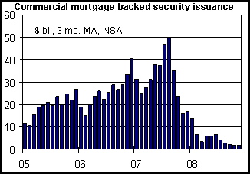
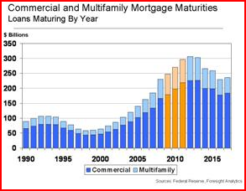
Commercial Leverage: Problems & Implications
Tightened Credit
  Higher DCRs and LVs
  Hard valuations, less financial engineering
  Recourse debt
  Real equity positions
Outlook for Commercial Debt
  Limited supply; flight to quality
  Tighter; increased equity and recourse
Refinancing Crisis
  No obvious sources of debt
  Banks struggling with carry-over problems
  No CMBS resurgence
Sources: JRDeLisle, RCAnalytics
Notes:
As noted in this part of the cycle much attention has been focused on a problems in the subprime credit market and credit swaps. Unfortunately, while the press, politicians and regulators have focused attention on those sectors, the commercial real estate market has escaped outside scrutiny. However, those on the street realize the lure of easy credit and lax underwriting was as prevalent as in the residential sector. Indeed, the commercial sector is facing a number of problems stemming from the turning tide in credit markets affecting both the ability of borrowers to pay (i.e., rising vacancy rates, declining rents) , and in the willingness of borrowers to pay in the face of erosion of the equity value and tighter credit.
The dramatic erosion in access to the capital for commercial investments is evidenced by the fact that a significant number of transactions in 2008 depending on the ability to assume existing financing. Going forward, assumptions will be much more difficult to affect with tightening credit standards, higher equity requirements, and a return to non-recourse debt carrying the day. In terms of credit for refinancing, the potential for a credit crisis over the near to intermediate term which will extend through 2010 suggests the environment will be characterized by limited credit supply, higher spreads, and tighter underwriting standards.

Slide 22
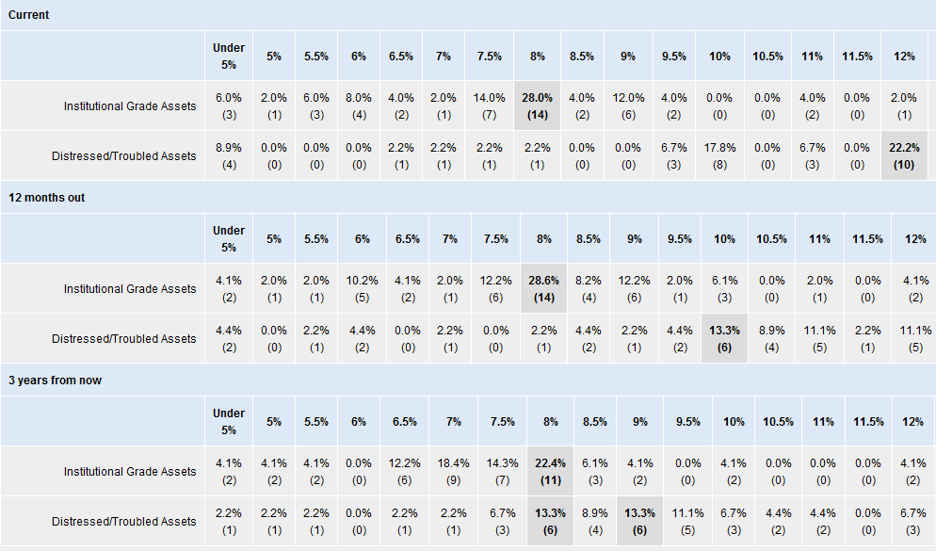
Current and Future National-Level Cap Rates
Sources: JRDeLisle, IREM Survey Respondents
Notes:
To explore whether Seattle-ites were parochial and inner focused or whether they were in tune in the national view on cap rates. As noted in the exhibit, there were some differences between the national NAIOP responses which are boxed above and the Seattle respondents. However, the responses were not markedly different, suggesting the importance of real estate capital markets to the local real estate community. In general, Cap Rates for core properties are around 8% plus or minus and expected to widen a bit before settling back to that level in three years.
Cap rates for distressed rates are some 400+/- basis points higher, both now and one year out, with averages in the 12% rate and then falling back to 10% or 200bp above core assets. It should be noted, however, that these cap rates are for income in place rather than potential net income. So, if a distressed building is 40-60% or less leased, the effective cap rate would be much higher.

Slide 23
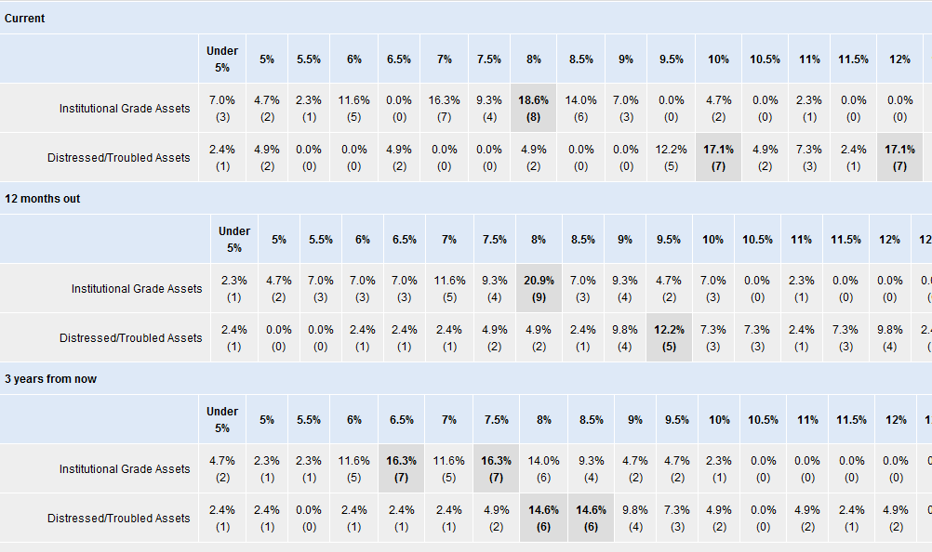
Seattle Cap Rates
Sources: JRDeLisle, IREM Survey Respondents
Notes:
The Seattle area respondents provided their crystal ball and current view of local cap rates. Interestingly, for core assets the current rates were around national averages, but respondents expected them to be 50-100bp higher in 12 months and reflect a much wider spread than the national averages in 3 years. Local distressed Cap Rates and national ones were generally in line although they did not think they were currently as bad as the national rates.

Slide 24
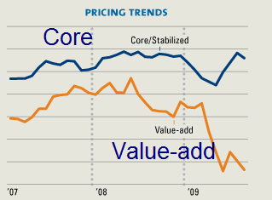
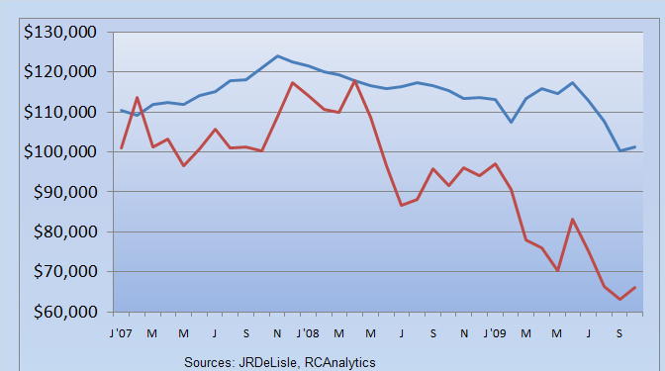
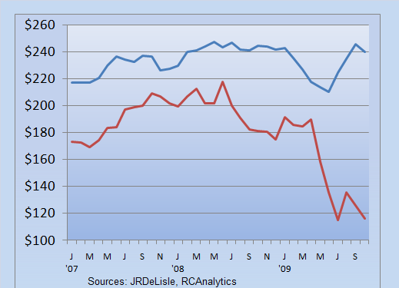
Emergence of Two-Tiered Pricing System
Apartments/Unit
Core
Value-add
Suburban Office/SF
Core
Value-add
Notes:
Although transaction levels have been relatively low, the transactions that have occurred reveal the emergence of a two-tiered pricing system in which core assets (e.g., proven assets, fully leased, solid cash flows) are trading at a much higher value than distressed assets. This situation is likely to hold, although the glut of distressed assets that will hit the market is likely to create some convergence as buyers find it difficult to identify core assets from the impending flood of listings.

Slide 25
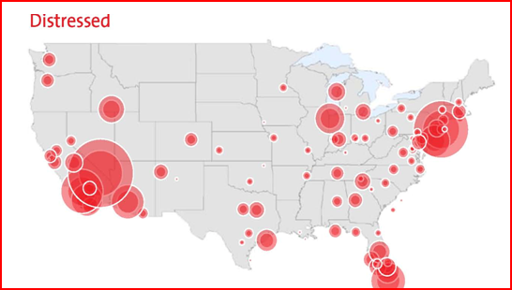
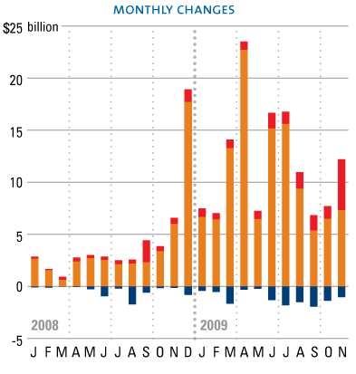
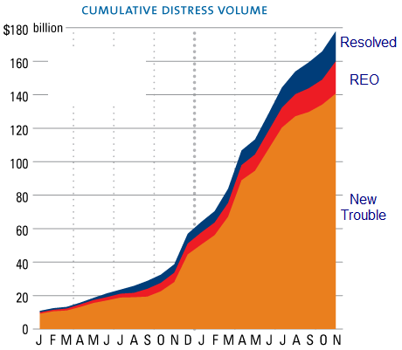
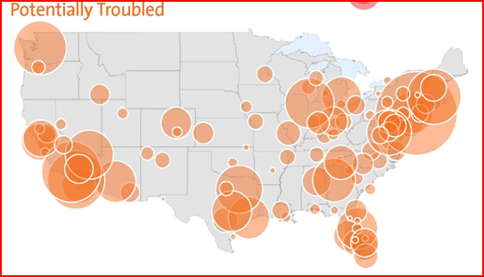
What’s Happening on the Distressed RE Front?
Status and Location
Growth & Build-up
Source: Real Capital Analytics
Notes:
The graphs on the right of the screen indicates the current volume of distressed assets as well as the potentially troubled assets in the pipeline. Again the impendiing crisis in commercial real estate is widespread with current and impending problems spread across the country and few major markets escaping the problem. At the same time, the increase in the pipeline of distressed assets is building, with few actually hitting the market. When the assets start trading, there may be a flood of activity that disrupts the overall commercial real estate market which will adversely affect non-distressed assets as well as those in distress.

Slide 26
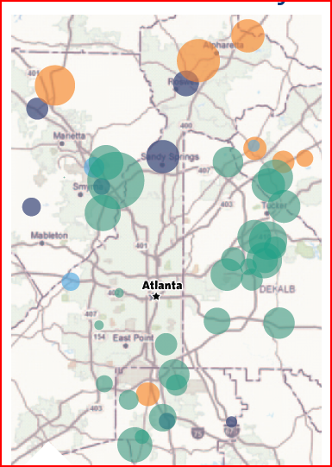


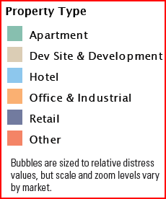


Distressed Asset Spillover: Why it Matters
Phipps Tower: Crescent/Manulife
Wells Fargo Lead,
Regions Follows
Two Alliance Center:
Tishman
3630 Peachtree: Duke/Pope & Land
Bank of America Lead
Regions Lead
Terminus 200:
Cousins
Sources: RCA, WSJ 4/21/2009
Notes:
While some owners of commercial real estate may take solace in the fact that their assets are performing well, it’s important to recognize that the potential disposition of distressed assets at bargain basement prices can have an eroding effect on the NOI of strong buildings. This risk was highlighted by exploring the the distribution of “currently distressed” and “potentially distressed” assets in the Atlanta market. These troubled spots were then superimposed on a map indicating the imminent delivery of four major speculative buildings in Buckhead, one of the leading submarkets in Atlanta.
The slide also notes the “doubling down” of some of the major banks who have assumed significant risk exposures in concentrated areas. To the extent that distressed buyers are willing to discount rents to capture tenants, grab landlords should be on notice and paying much more attention to their existing tenants. Indeed some owners are renegotiate leases to try to extend the terms in return for a reduction in rents. The strategy may become more widespread but may also be delayed as tenants are developing a better understanding of the condition in Outlook for the commercial market.

Slide 27
Players in Distressed Asset Market
REITs
  Have reversed downward spiral
  Significant new capital raised through Sept 2009
  Low Dividends suggest accretive opportunities
Global Investors
  Western European
  Middle East
  Asia/Australia
Domestic Funds
  Significant growth inUS
  New Opportunity Funds
  New Value-Plus Funds
Notes:
A number of sources have suggested that well over $200 billion of equity capital has been assembled to acquire commercial real estate at distressed prices. While much of this capital remains on the sidelines, it is interesting to note the general sources of capital that are lined up. After a difficult 2008, REITs have been doing fairly well in year-to-date performance, with a number of larger REITs raising some $12 billion of capital in the first half of the year. The ability to raise capital for the otherwise distressed asset class is reminiscent of the mid-90s when REIT market cap surged from sub-$10billion to some $200 billion.
Offshore investors will also likely be active players in the US real estate market when it begins to move, although the US real estate recovery is expected to lag other developed nations. Finally, a number of existing and new domestic funds will be established over the near term as sponsors try to take advantage of the market malaise and the strong talent who could implement successful investment programs on the street.

Slide 28
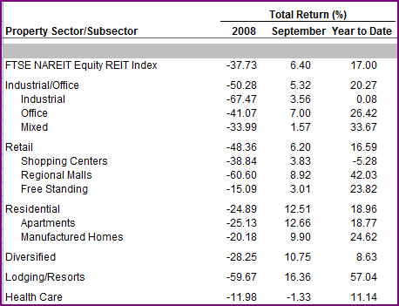

REITs: Back to the Future?
Changing Game?
  Through June, raised $12 billion in stock
  Who?
    Office: Boston Properties, Vornado Realty Trust
    Retail: Regency Centers, Simon Property Group
Challenges
  Existing Leverage
  Eroding Fundamentals
  Falling Property Values
Accretive?
Buy at 8-10, payout 4-6
Notes:
While a select number of REITs have indeed raised capital and are trying to manage investor expectations, their aspirations to take advantage of the market cycle may not pan out as expected. This is due to the fact the broader industry is being subjected to a number of challenges to business as usual including leverage, erosion in NOI, and falling property values. In this environment, the REIT sector should be closely monitored to identify any emerging trends that might spill over to the broader market.
REITS are also under some pressure to mark assets to market, a requirement that could be very revealing. Despite recent issues, the low payout rate of REITs compared to Cap rates may allow them to engage in accretive investing as they did in the 90s. That is, with the spread between cap rates and dividends, the more they buy, the better they look.

Slide 29
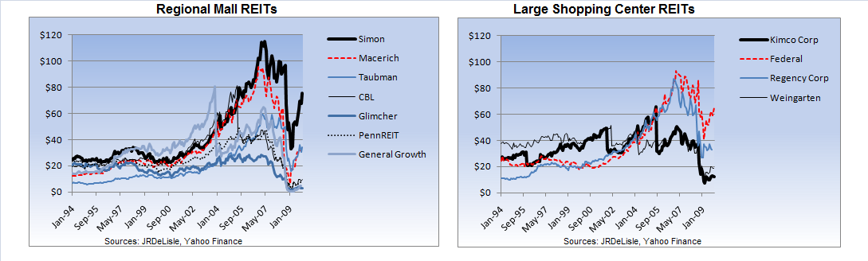
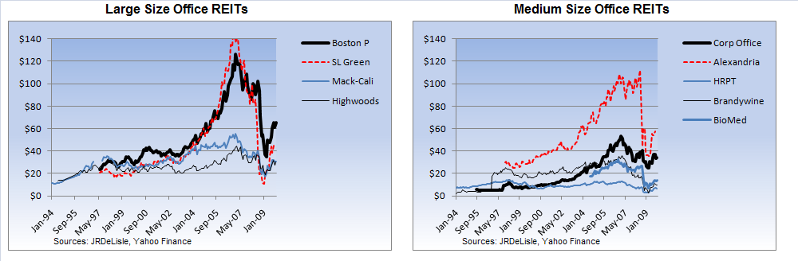
REIT Stock Prices: Retail and Office
Notes:
This slide plots the closing stock prices for retail and office REITs through November 2009. Note the general bounce in prices in the 3rd quarter. Each property sector has some outperformers although all were pulled down.

Slide 30
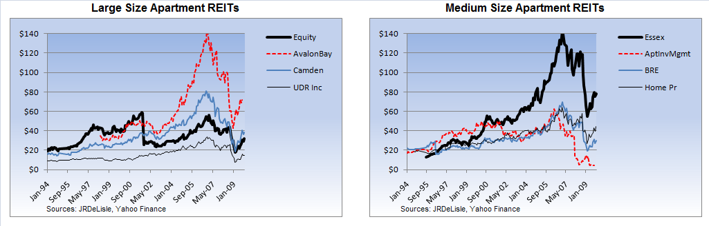
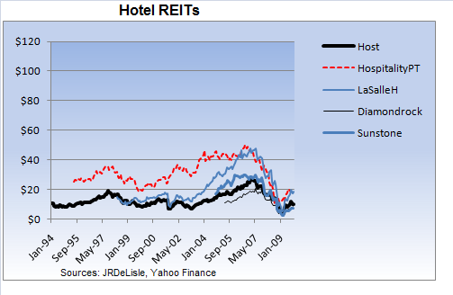
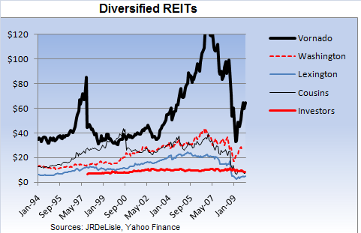
Apartment, Hotel and Diversified REITs
Notes:
Apartment and diversified REITs exhibit a similar pattern to office and retail, although some have been relatively flat. Interestingly, almost all REIT prices contracted in mid-2007, ahead of the private market and transactions which continued to increase well into 2008. At the same time, the recent bounce in prices is positive, although eroding fundamentals create a cloud over the sector.

Slide 31
Part III Summary: Real Estate Capital Markets
Macro-economic Environment
Economy showing some signs of turning
Businesses struggling, credit tight
Consumers bearish
Real Estate Capital Market
Still shut down; some activity increasing
Rising Cap rates, tighter credit, picky sources
Major challenge in de-levering
Notes:
In summarizing the broad economic and capital markets, the data are mixed to negative. Whether the fledgling economic recovery will take hold remains a major question. For the first time in years, capital flows to the asset class are likely to continue to decline over the near term until the capital sitting on the sidelines makes its move. Given the uncertainty surrounding the future of the debt side of the market, significant dowside risk that has yet been priced into the market hangs over the industry.

Slide 32
Commercial Market Fundamentals
Vacancy Rates
Suburban Office
Downtown Office
Industrial
Retail
Development (msf)
Apartments
Apartments
Industrial
Office
Retail
Source: Torto Wheaton Research, REIS, 2009 Emerging Trends
Notes:
The commercial property sector is facing significant stress as market fundamental continue to erode in the face of a weak economy and tempered demand. Development activity has fallen off although some projects in the pipeline continue to cloud the market. A growing number of projects have been abandoned, while many spec buildings are struggling to find tenants.
Vacancy rates are rising across the board, hitting a property types and many markets. These factors and the weak economy are creating additional drag on the commercial sector leaving many owners and developers hanging on in an effort to survive.

Slide 33
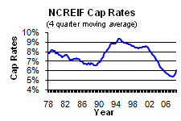
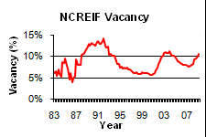
Spatial & Capital De-connect and Re-connect
Capital Market
BV
(Bubble Value)
Capital
Market
Bubble
Debt -20%+/-
Bubble
Cap Rate Rise
Interest Rates/Debt Rise
Warranted
Construction: Expanding Demand
Spatial Market
Cap R -20%+/-
Bubble
Market -10-20%+/-
Softening
Rising Rents
Vacancy Up
Rents Down
-40-60%
Values
Market
Inefficiency
Notes:
Given the multidimensional nature of real estate and its fixed location, real estate is subject to a number of external forces which change over time. These cyclical forces include the broader macroeconomic environment, capital markets and spatial markets. Each of these forces has a temporal nature which leads to market cycles characterized by periods of excesses or shortages of space, both relatively and in absolute terms. Since some of these forces are correlated, they can put pressure on the nature ebb and flow of markets and add to the amplitude and frequency of market cycles or waves. One of the more recent “externalities” is the surge in capital flows to the asset class which led to imbalances on the supply/demand side of the equation, as well as on the pricing. This latter occurred as a result of shortages of investable product which, due to the lags in construction and supply, created upward pressure on prices for existing assets and declining yields.
Going forward, we are likely to be facing a prolonged period of heightened cycles, both in terms of frequency and severity. Drawing on my experience in the 90s and what I have seen in terms of the spatial/capital divide, I believe institutional property in mark-to-market accounts may lose 40-60% of value. If so, we’re slightly more than half way there; a difficult outlook at best.

Slide 34
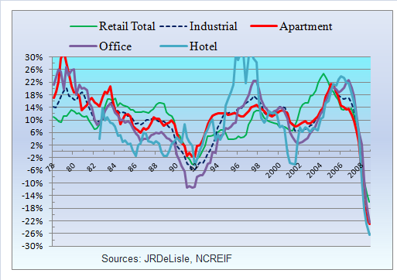

NCREIF Property Type Returns
Total Return
Income Return (Cap Rate)
Cap Rate: Long Term
200 bp Gap
38%
Loss
Notes:
This slide plots the NCREIF returns through the 3Q of 2009. As noted, the decline in values (capital) and total returns is unprecedented. Even with the declines and a slight uptick in income returns (e.g., implicit cap rates) there is more bad news to come with rates 200-300bp below long-term averages.

Slide 35
Part IV Summary: The Spatial Markets
Macro-economic Environment
Economy showing some signs of turning
Businesses struggling, credit tight
Consumers bearish
Real Estate Capital Market
Still shut down; some activity increasing
Rising Cap rates, tighter credit, picky sources
Major challenge in de-levering
Spatial Market
Fundamentals continue to erode lagging economy
Vacancy rates rising, rents falling
Stagnant demand, leasing sluggish
Notes:
In looking at the snapshot of the national and local spatial markets --supply and demand for real estate-- the bottom line echoes that of the broader economy and capital markets. That is, there is some additional downside risk associated with a combination of a slowing economy, tighter credit, a renewed interest in risk, and weakening fundamentals. That situation should prevail over the near-intermediate term, with commercial real estate lagging the broader economic recovery which is well into 2010 at best. These will be interesting and challenging times with survival the a first-order goal for many as they are forced on the defensive. On the other hand, some players will be looking to exploit the opportunities that will come in as the market malaise and lack of capital continue to play out.

Slide 36




Part V: Bringing it Home to Seattle
Seattle vs. National Total Returns
Distressed in Seattle
Distressed P-Type Share vs. US
Seattle Returns by Property Type
Notes:
For several years, the commercial real estate market in Seattle has been ranked as one of the top investment markets in the ULI’s Emerging Trends publications. Indeed, record prices continued to be paid for local assets after the commercial sectors had begun to cool off in other markets. This led many local observers to contend, “We’re different.” Well, as shown in the graph of NCREIF returns in Seattle vs. the US, we were not so different after all….
While property crimes have fallen somewhat across the country, the top markets which includes Seattle has fared better than the average. Although Seattle comes out higher rankings, this divergence is unlikely to hold suggesting Seattle isn’t for some repricing for core commercial real estate.

Slide 37


Seattle Transactions and Cap Rates vs. National?
Seattle Transaction Volume: 2009
Seattle Cap vs. National by Property Type
Not as different as we thought
Notes:
In many respects Seattleites tend to believe they are different from the rest of the market. In order to test this theory one can compare cap rates. As noted in the upper right graph the Rates and Seattle are not different from national capitalization rates plotted by property type. While property crimes have fallen somewhat across the country, the top markets which includes Seattle has fared better than the average. Although Seattle comes out higher rankings, this divergence is unlikely to hold suggesting Seattle isn’t for some repricing for core commercial real estate.

Slide 38

Current and Future Seattle-Area Cap Rates
Sources: JRDeLisle, IREM Survey Respondents
Notes:
The Seattle area respondents provided their crystal ball and current view of local cap rates. Interestingly, for core assets the current rates were around national averages, but respondents expected them to be 50-100bp higher in 12 months and reflect a much wider spread than the national averages in 3 years. Local distressed Cap Rates and national ones were generally in line.

Slide 39

Additional Insights on Seattle Market
Sources: JRDeLisle, IREM Survey Respondents
Notes:
To get additional insights on the prospects for the local commercial real estate markets, respondents were asked to agree or disagree to a number of statements regarding real estate fundamentals. As noted, the responses to this series of questions was more widespread then for others, suggesting the uncertainty surrounding the commercial market. On the “agree” side of the equation, respondents concurred that they believed opportunistic capital would return to the Seattle market by the end of the 2nd quarter of 2010, and that distressed asset listings will increase. They also saw stagnant capital flows into Seattle, due in part to the expectation of falling values as they contend will occur and will drag mark-to-market properties down and additional 20-40% on top of recent declines in value.
They agreed that the “talk” was real and that Seattle was in for some difficult times. They also saw an increase in distressed assets and REO as owners increasingly walked from projects that were upside down with values under mortgage balances. Finally, they do not see a near-term turnaround in the condo market which is being vindicated by the spate of auction sales and other desperate attempts to stimulate the market and move products out the door.

Slide 40

Seattle Market Risks: Significant/Not
Sources: JRDeLisle, IREM Survey Respondents
Notes:
To help identify and quantify some of the risks the Seattle market faces, the respondents were generally concerned about each of the risks as noted by the boxed outlines.
As with earlier responses on the national front, the outlook for credit and commercial debt and absence of replacement debt is the most significant risk the local industry will face. This risk will be exacerbated by the erosion in market fundamentals that will cause additional value declines. Respondents anticipate an increasing number of borrowers will begin to walk when faced with difficult refinancing decisions regarding recourse and equity positions on upside down projects.
Most anticipate banks to take an even harder line on commercial real estate which has ominous overtones for those who’s assets need refinancing or some capital infusion. There is also concern over the potential for the market to get jammed up as the flood of distressed assets hits the street. Finally, even though the Seattle market will lag the economic recovery more than usual, the fate of the commercial market hangs on a sustained economic recovery.

Slide 41

Part V. “Real” Opportunities in Seattle RE
Sources: JRDeLisle, IREM Survey Respondents
Notes:
In the bulk of my presentation, it may appear I focused on the negative side of the market with a “glass half full” view. While my comments may have been sobering, they were intended to “tell it like it is” and more so, “what it will be” as I have for the past several years when the excesses of easy credit and lack of attention to fundamentals began to dominate the market. In spite of generally bad news, there will be a number of local opportunities when the market starts moving again.
To determine if these opportunities were real or just “ivory tower” wishes, the survey tests respondents’ perceptions of how “real” various opportunities might be. As in the case of risks, the respondents agreed with many of the opportunistic statements, especially with regard to the ability to take advantage of distressed assets that will begin flooding the market in 2010. The best opportunities surrounded working with distressed assets. These opportunities ranged from outright acquisitions, to providing professional services for troubled owners, lenders and potential borrowers. While some disagreed, most agreed that this would not be a time of “no brainer” investing; a position I support.
Based on my experience in the 90s, the problems the market will face are real and extremely complex. Thus, sifting and winnowing among distressed assets will be difficult and require more discipline and real estate acumen than required in the past decade. While many players are posturing to take on these challenges, I am concerned that they may not understand just how difficult it will be to avoid additional landmines lurking beneath the surface of individual projects and pooled offerings.

Slide 42
Other Challenges: Players and Products
Players
  Emergence of new players will create further problems
  Many naïve buyers will clog up the system
  Intermediaries will raise capital but struggle to deploy
  Infrastructure not in place to deal with sheer volume of deals
New Funds
  Expect a spate of new funds, some with experience others not
  Closed-end fund structures will be popular
  Off-shore investors will be a major target for money managers
Products
  A spate of new products will be introduced to lay off risk
  New Partnership arrangements will match expertise with capital
Notes:
Over the past 6-9 months, a number of players have been lining up to step into the commercial real estate fray in the US. This trend has both positive and negative implications. On the positive side, there will clearly be opportunities to take advantage of the turmoil in the commercial market and new players, unencumbered by existing problems may be best able to exploit them. I am concerned that the barriers to entry are relatively low and some of these new players will lack the insight, expertise and resources to be able to navigate through these troubled waters. The good news is there are a lot of talented professionals on the street as a result of staffing cutbacks that have already occurred in many firms. The hope is that sponsors and investors will ask the hard organizational questions to ensure the talent and resources are adequate to deal with what will be an extremely complex market where a lot of money will be lost by those who do not respect the challenges in front of them.
In addition to new sponsoring entities, the market is likely to see a spate of new funds and new products that will purport to be able to exploit the opportunities in the commercial arena without taking on excess risk. Since many of these entities will lack track records, investors will have to make decisions based on the personnel, organizational structure and resource commitments. At the same time, they will have to decide the best organizational structure and type of relationships that will best protect them in the face of difficult decisions that will have to be made in the frothy market.

Slide 43

Conclusion: What to do? Back to School?
So, To Walk, To Talk, To Walk the Talk???That is the question….
  There is no one answer….
  Critical thinking and survival instincts will rule…
  If not, there’s always school….
Back to the Future…..
http://jrdelisle.com
Notes:
In the current stage of the real estate cycle, many difficult decisions will have to be made. Some will be focused on expanding wealth, while others will be focused on damage control and survival. During this period, being connected to the rapidly changing markets, and having solid on-going relationships will be more important than ever. To help, I will try to stay on top of the unfolding scene and, where possible, try to get ahead of the curve. I offer my personal website http://jrdelisle.com with more features to come including an AskDrD interactive element. My full text articles on Financial Views dating back 10 years are also available in the Market Watch section. Good luck and thanks for the opportunity to share my thoughts and to stay connected via the survey and audience feedback.

